Slide 1
Fire without Matches
Travis Few
-- Scoutmaster Troop 5, Scott AFB
-- Assistant Cubmaster Pack 21, Scott AFB
-- primitive skills instructor

Slide 2
Contact Info
This PowerPoint and all videos are located at:
https://www.tf-links.com/uos-fire
Email: tfew@toofew.net
Phone: 605-415-2809

Slide 3
Safety
Who can build and start a fire in BSA
Adults, Scout BSA Scouts w/ Firem’n Chit, Webelos doing Cast Iron Chef or Cast Away w/ adult
From the Guide for Safe Scouting
Using liquid fuels for starting any type of fire—including lighting damp wood, charcoal, and ceremonial campfires or displays—is prohibited.
No flames in tents. This includes burning any solid, liquid, gel, or gas fuel—including tents or teepees that feature or support stoves or fires; and any chemical-fueled equipment or catalytic heaters.
Use of accelerants, chemicals, or pyrotechnics to start fires or in ceremonies (exception: solid fire starters designed and manufactured for this purpose)

Slide 4
General Guidance (Adapted from Firem’n Chit)
Build a campfire only when necessary and have the necessary permits (regulations vary by locality)
Minimize campfire impacts or use existing fire lays consistent with the principles of Leave No Trace. Check to see that all flammable material is cleared at least 5 feet in all directions from fire (total 10 feet)
Safely use and store fire-starting materials
See that fire is always attended to
Make sure that water and/or a shovel is readily available. Promptly report any wildfire to the proper authorities
Use the cold-out test to make sure the fire is cold out and will make sure the fire lay is cleaned before leaving it
Follow the Outdoor Code, the Guide to Safe Scouting, and the principles of Leave No Trace and Tread Lightly!

Slide 5
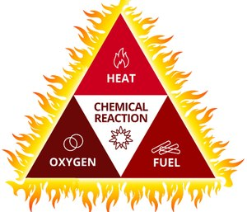
What fire needs
Heat
O2
Fuel

Slide 6
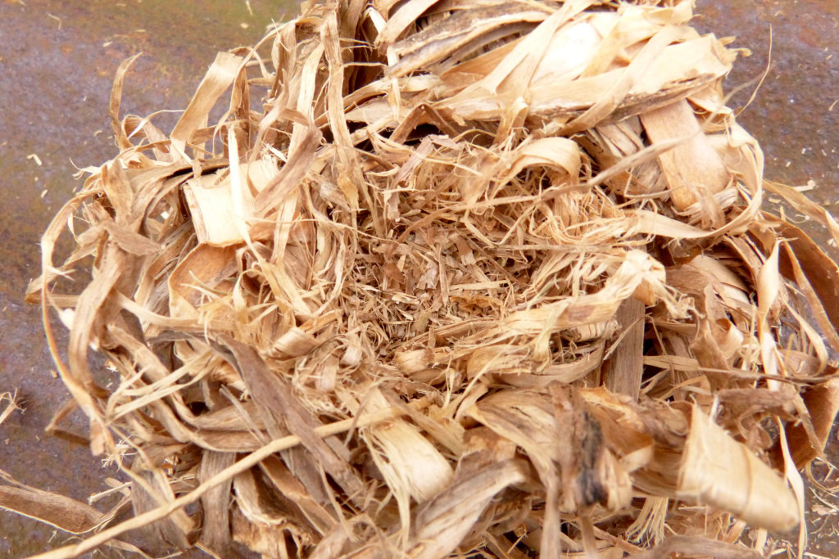
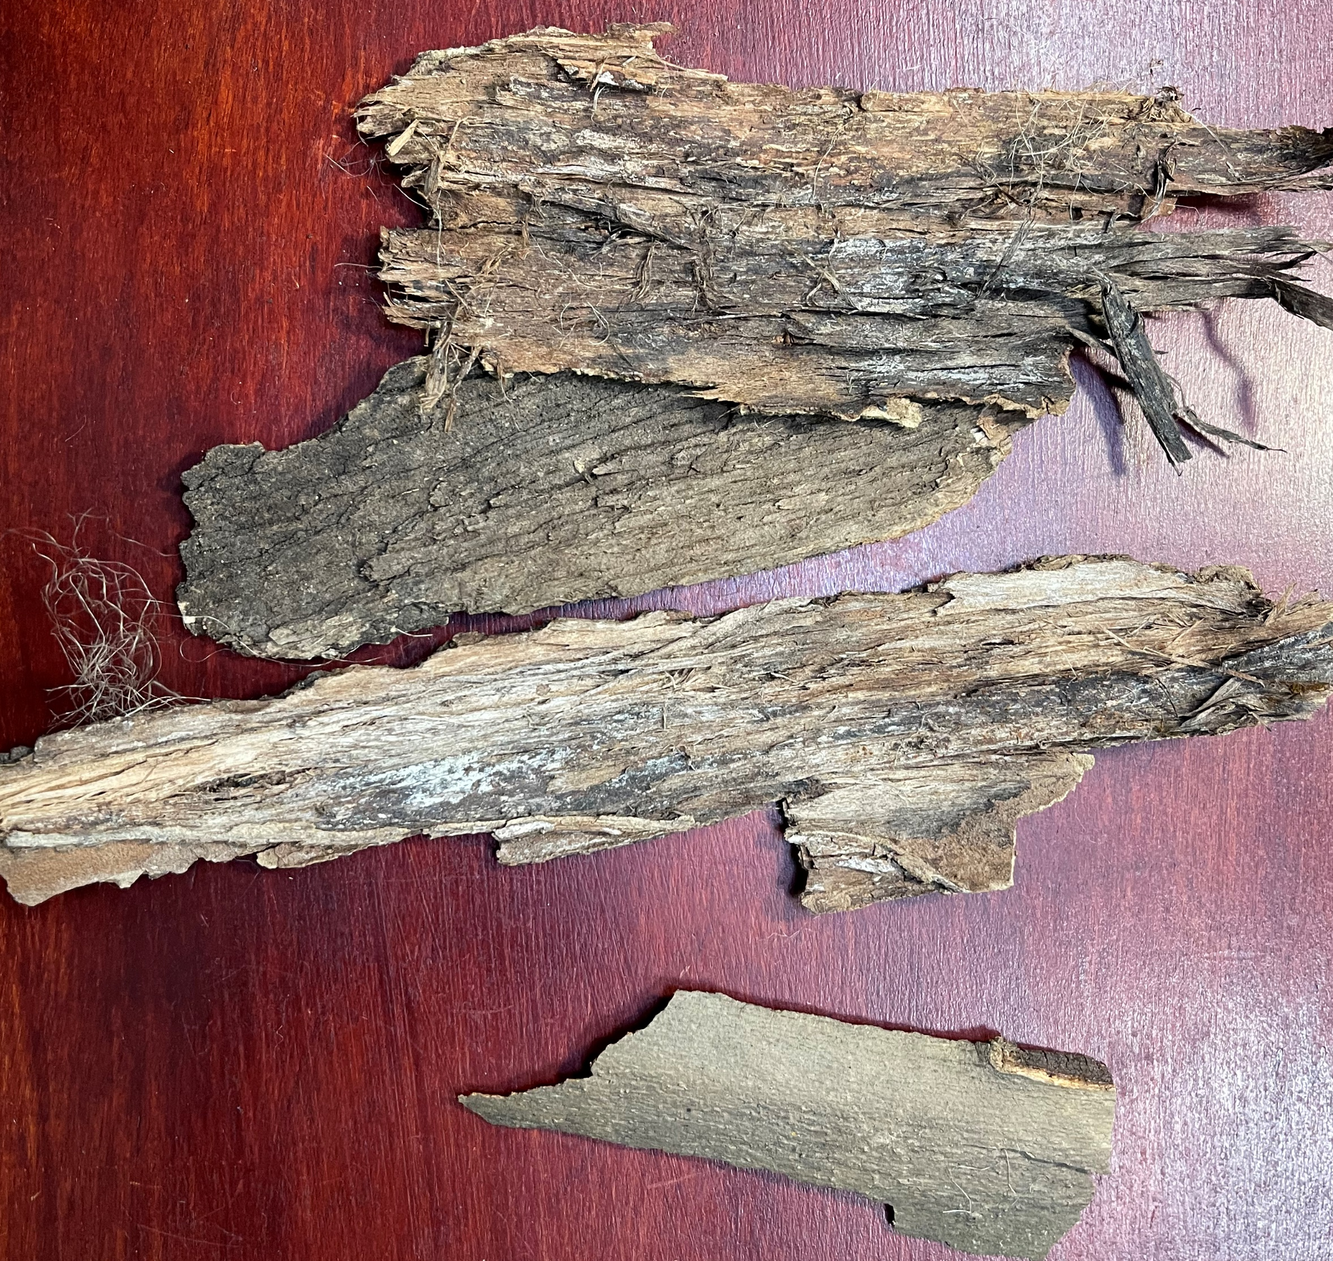
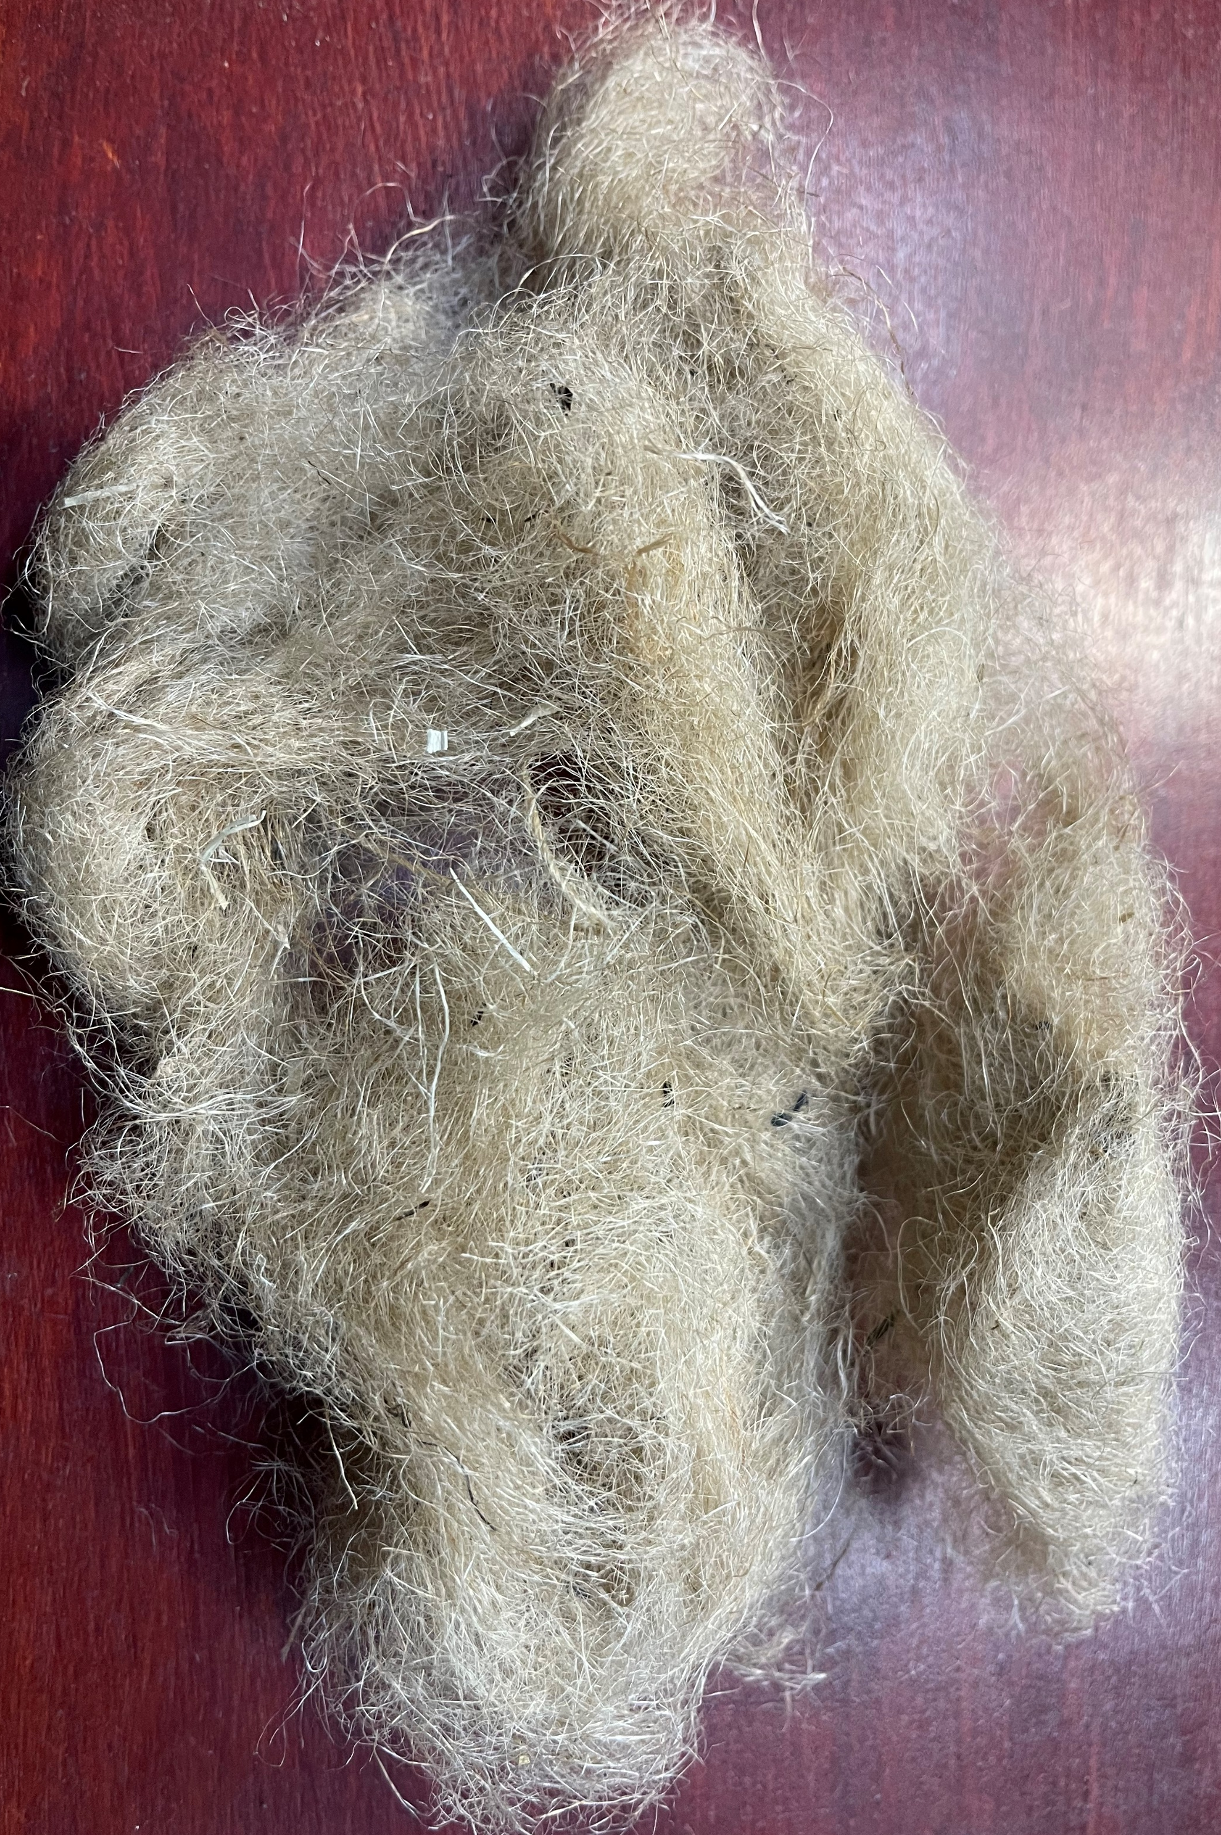
Tinder
Materials which will readily ignite with a spark
Smallest and easiest burning materials used to get a fire started
Toothpick sized wood up to wood that is the size of a pencil

Slide 7
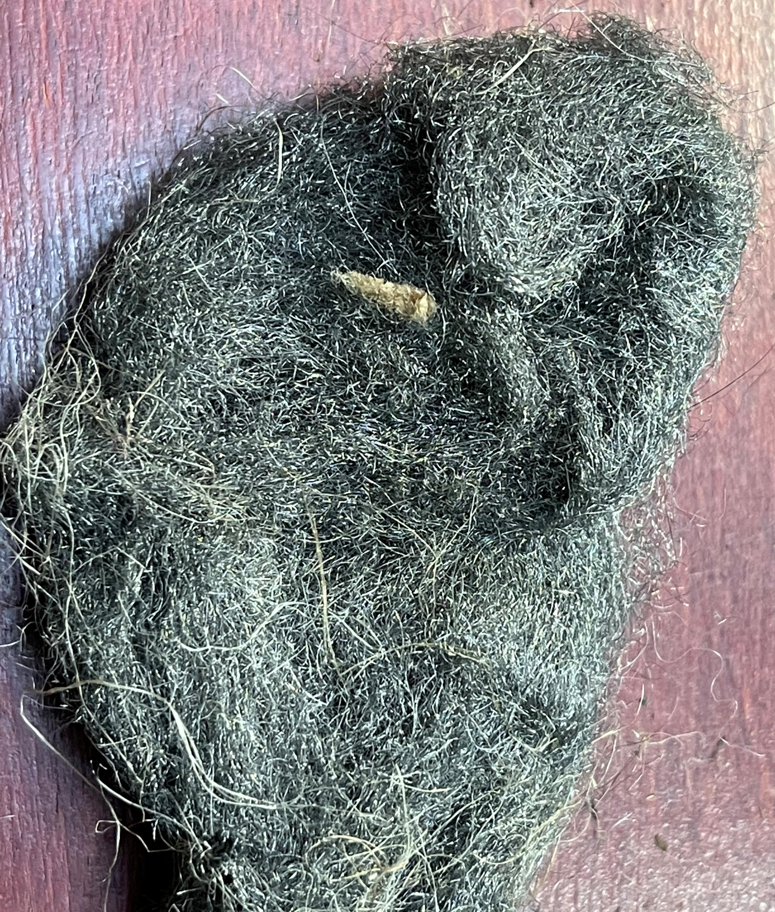
Manmade Tender
Char cloth
Jute twine (man processed natural fiber)
Cotton balls w/ or w/out Vaseline
Lint
Paper
Steel wool
Hexamine tablets
Commercial fire starter tabs
Bicycle inner tube rings

Slide 8
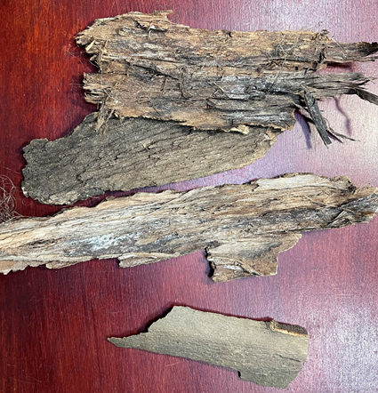
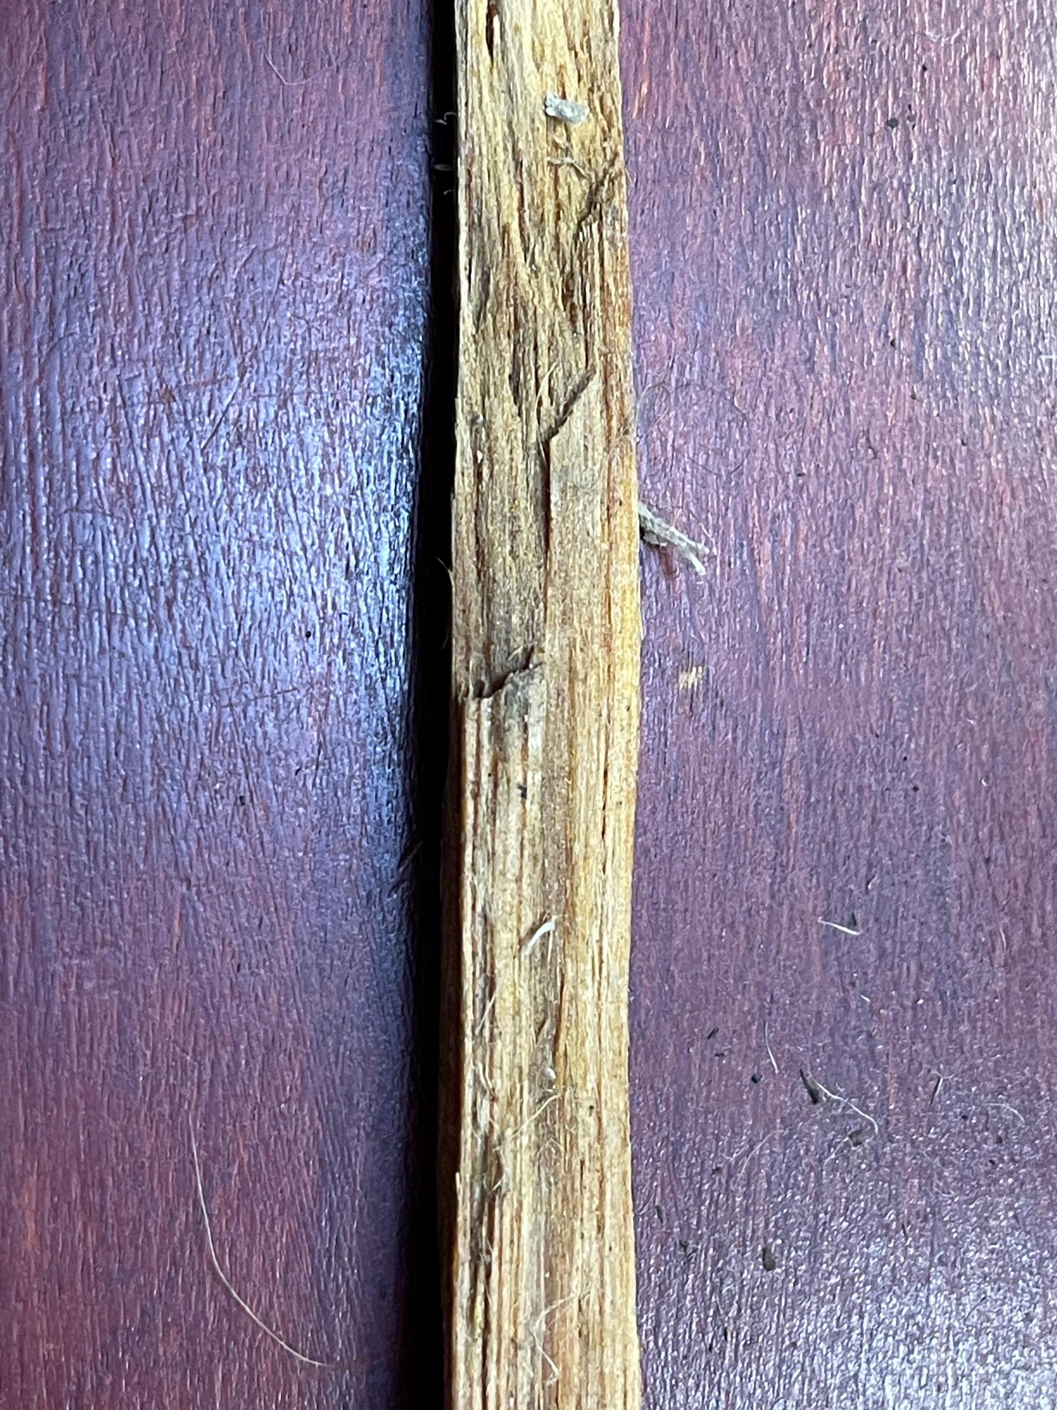
Natural Tender
Shaved bark
Dandelion head
Birch bark
Cattail fluff
Fat wood
Tinder fungus
Punk wood
Poplar Cotton

Slide 9
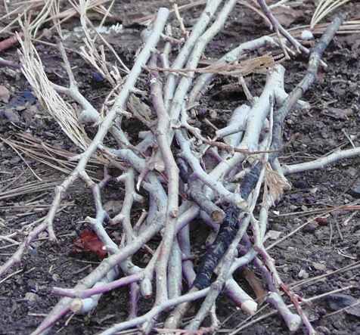
Kindling
Small pieces of grass, leaves and twigs
Size of a pencil up to pieces the diameter of your thumb

Slide 10
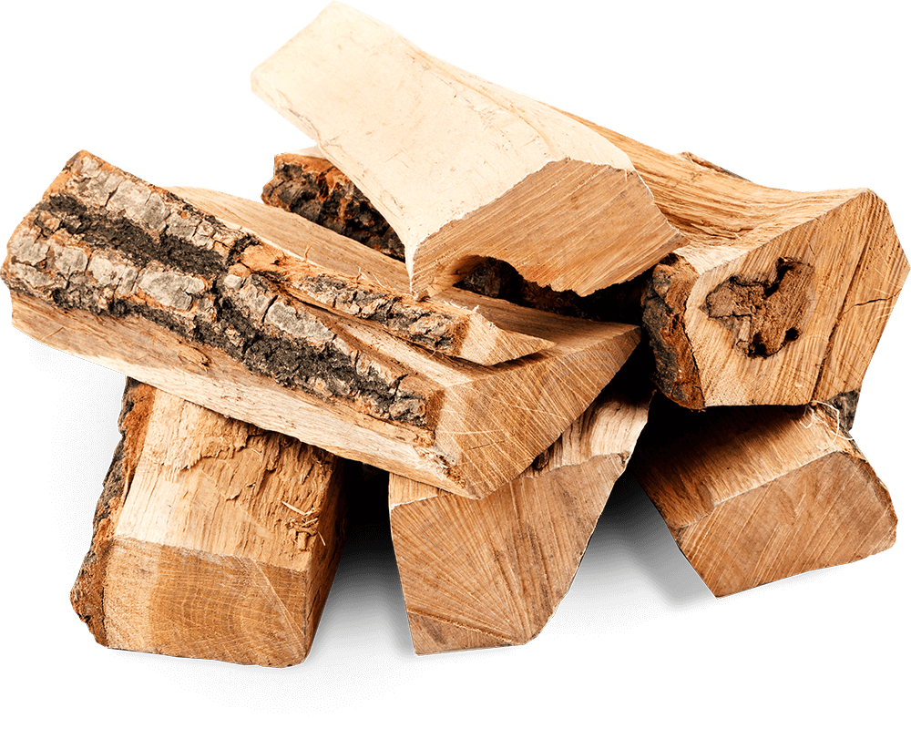
Wood - Sustaining fuel
Wood the diameter of your thumb and larger

Slide 11
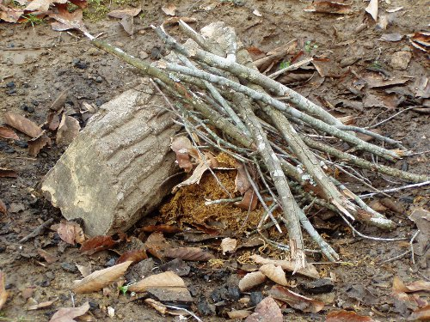
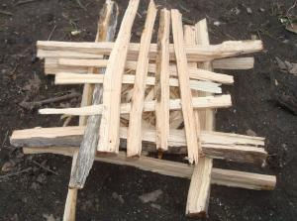
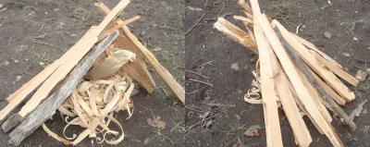
Fire Lays
Lean To
Teepee
Log Cabin
or

Slide 12
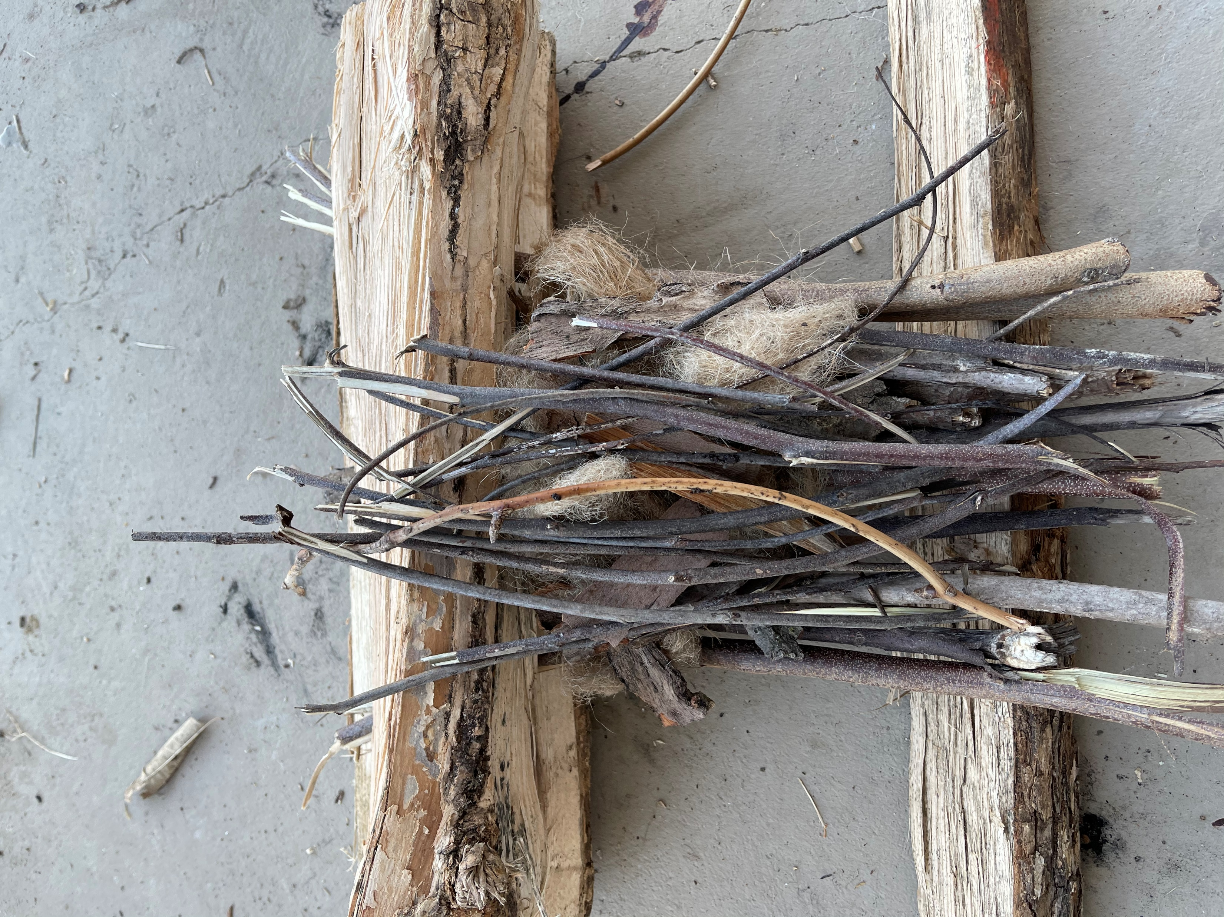
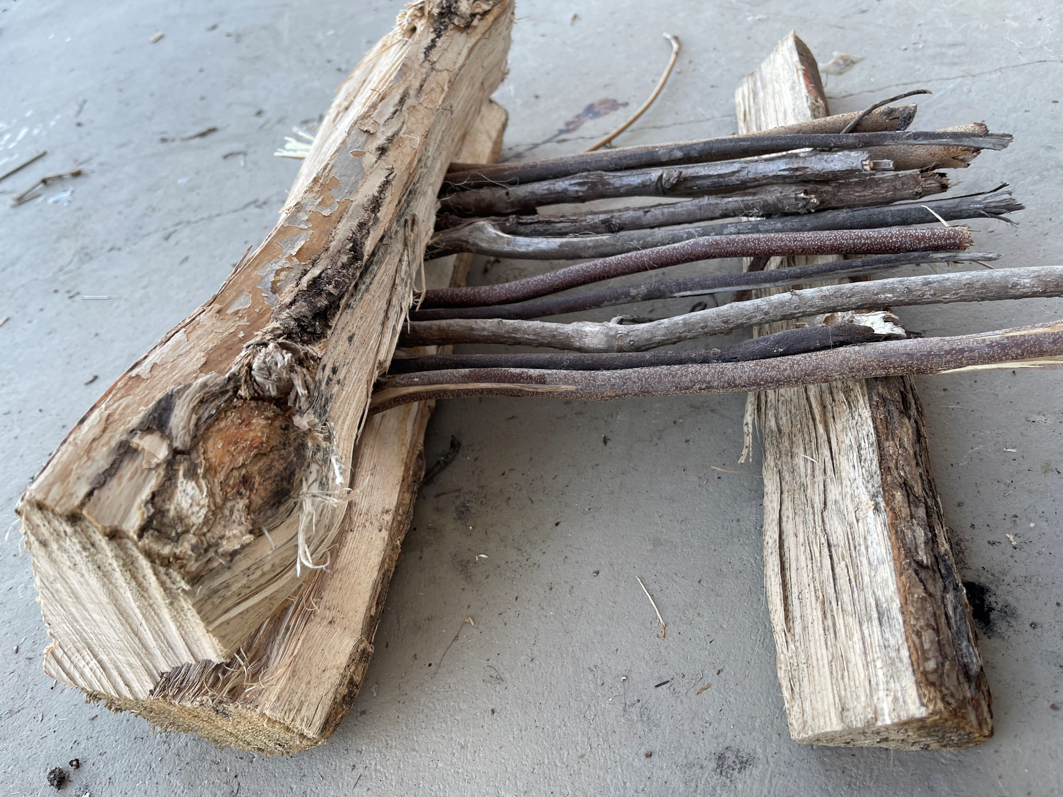
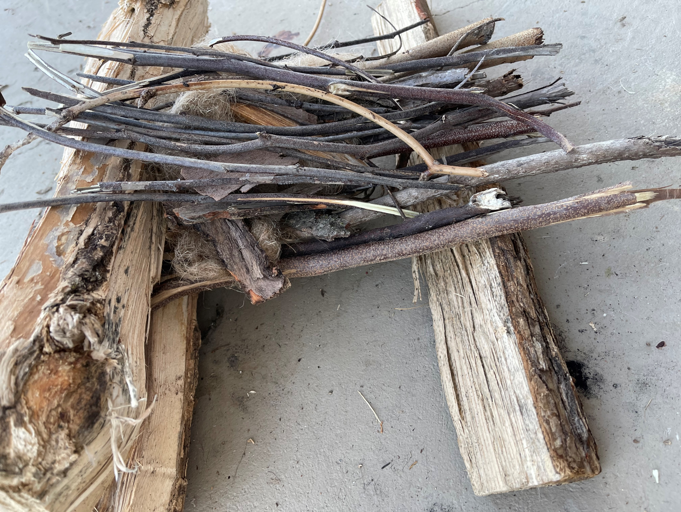
My favorite Fire Lay
A modified lean to/platform fire

Slide 13
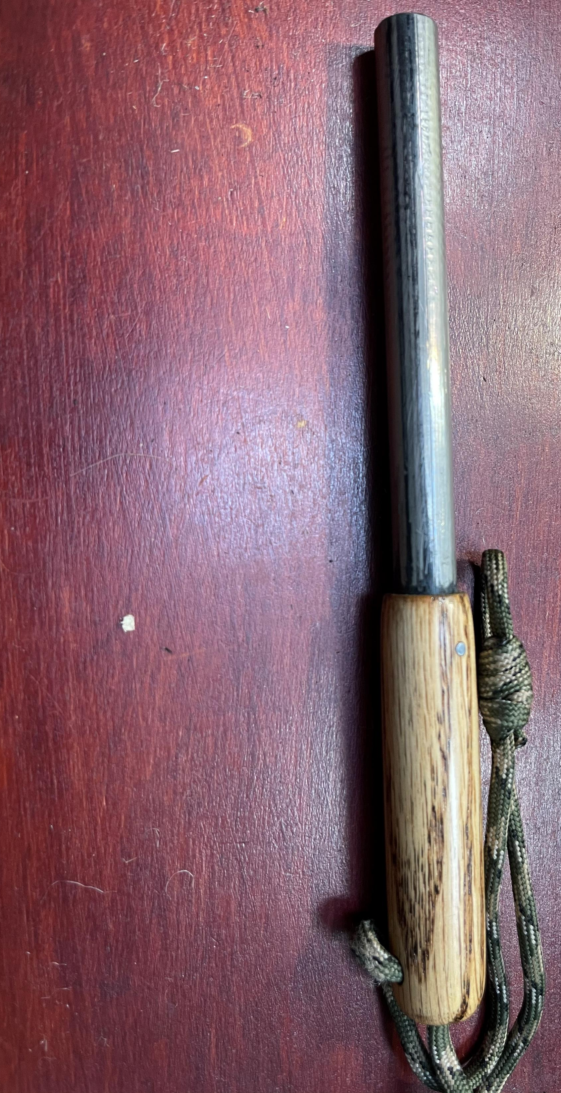
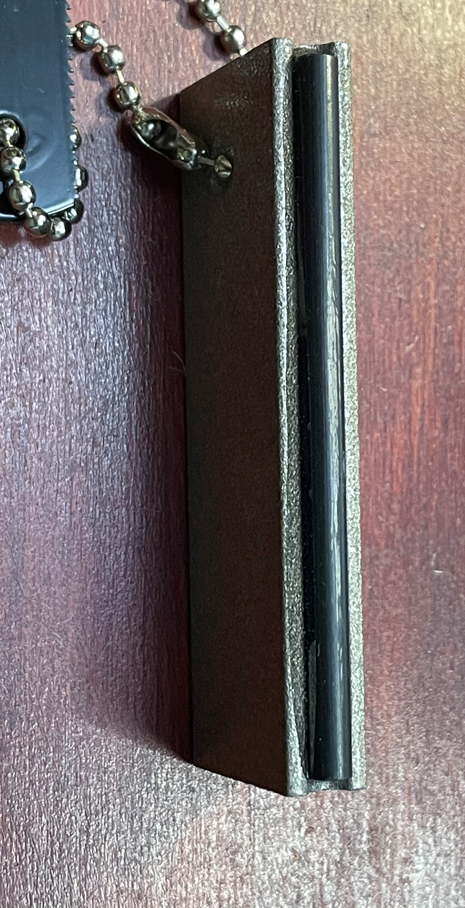
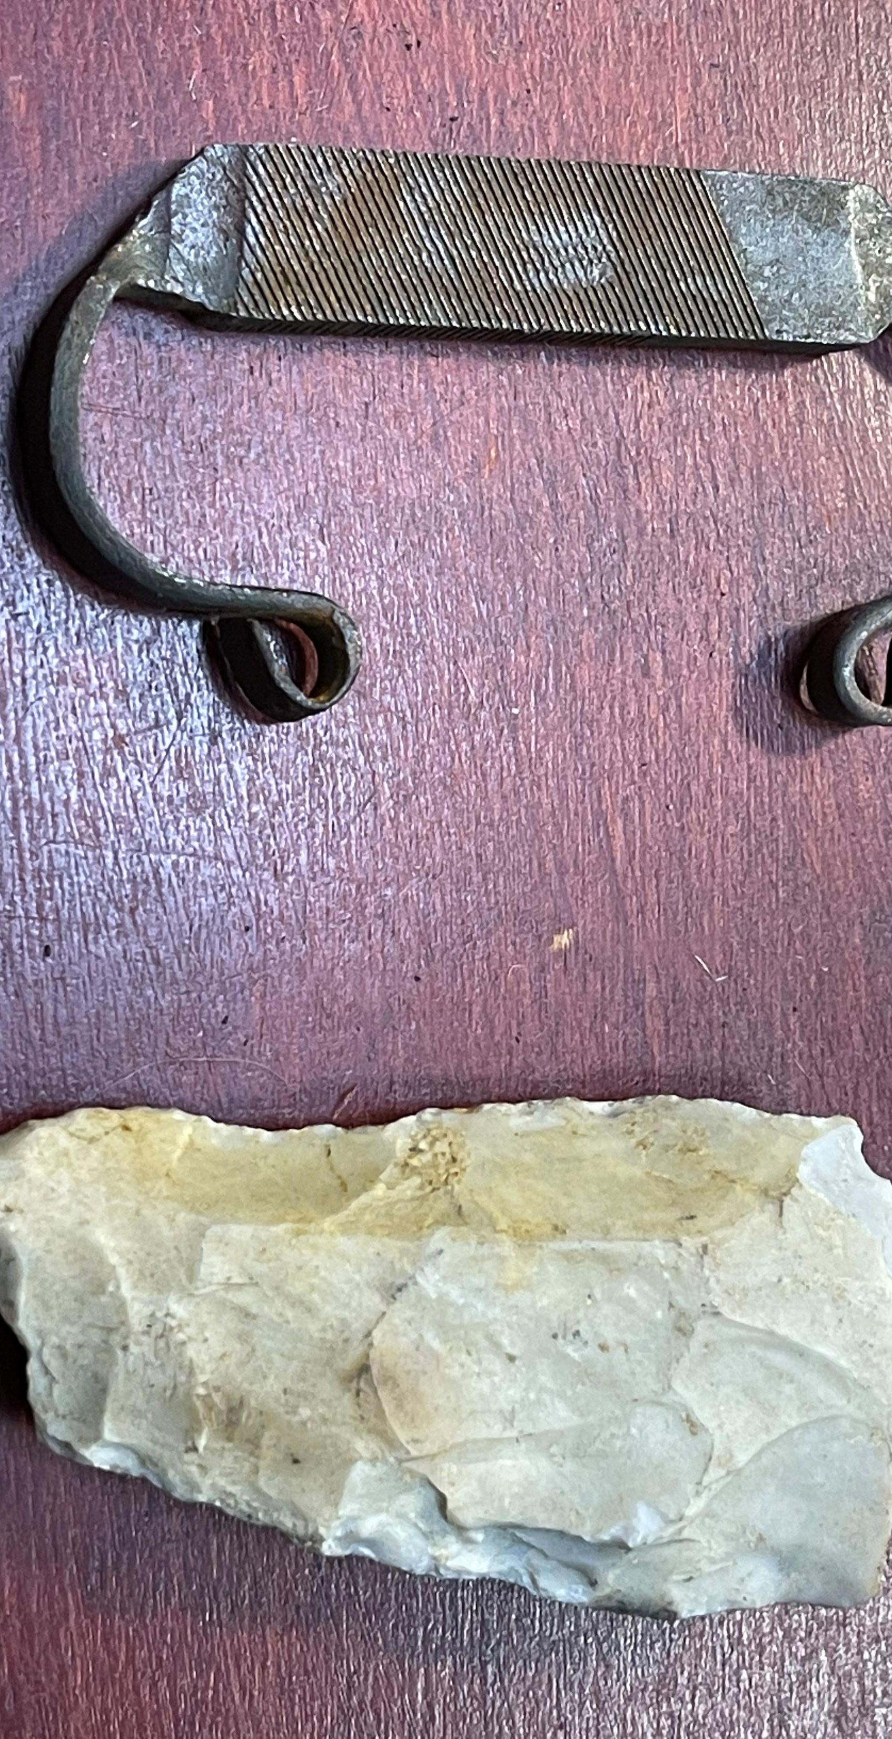
Sparking
Ferro Rod
Flint and Steel

Slide 14
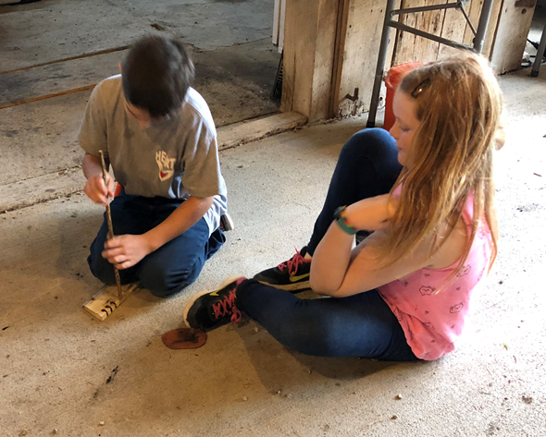
Friction
Bow Drill
Hand Drill
Fire Plow

Slide 15
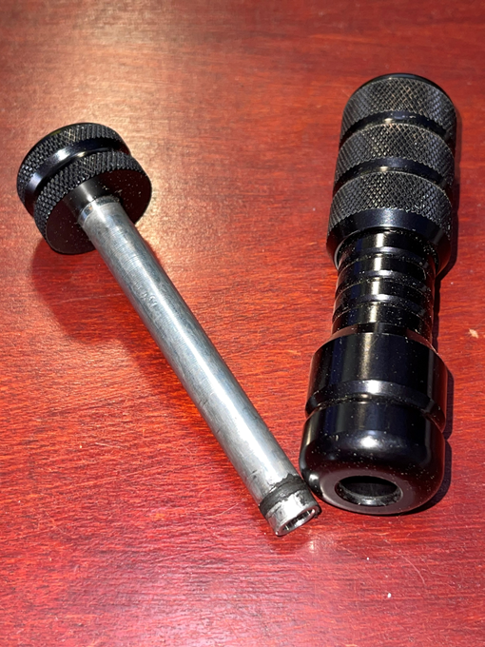
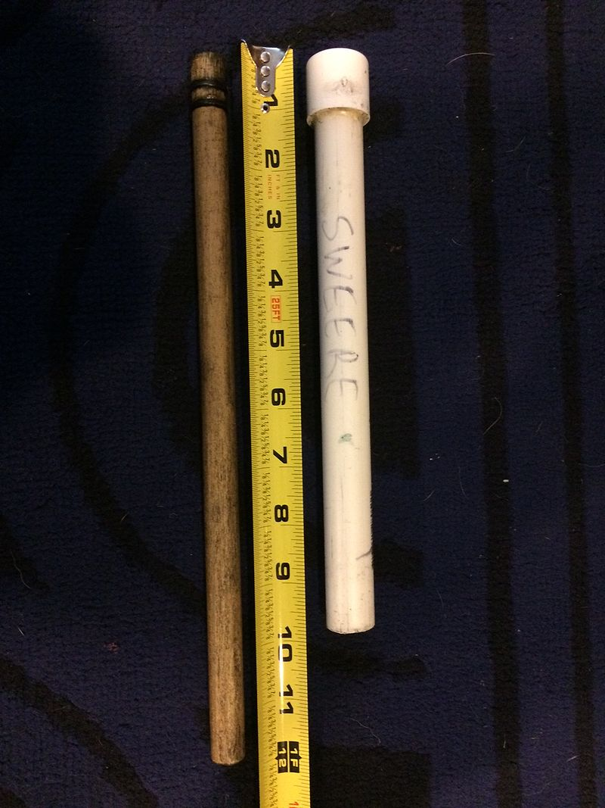
Compression
Rapid compression of a gas increases its pressure and its temperature at the same time
The same principle is used in the diesel engine to ignite the fuel in the cylinder
Fire pistons were invented by Southeast Asians (probably the Austronesian peoples)
Needs char material to work

Slide 16
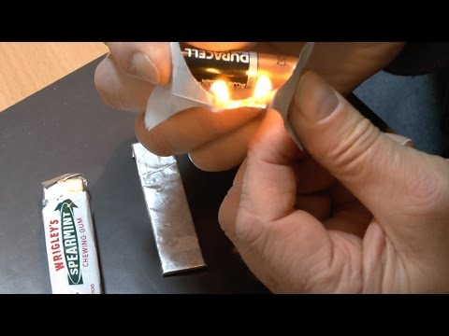
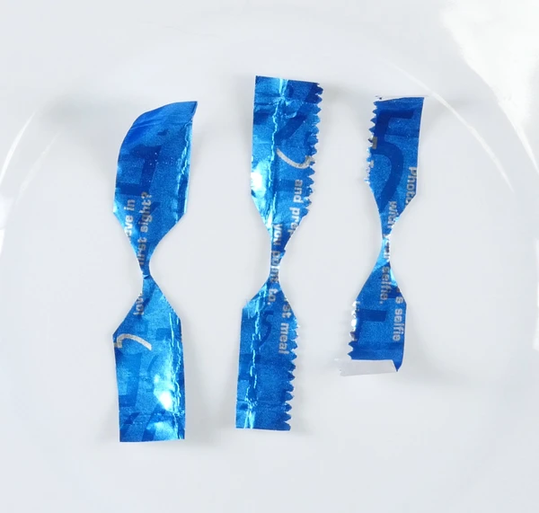
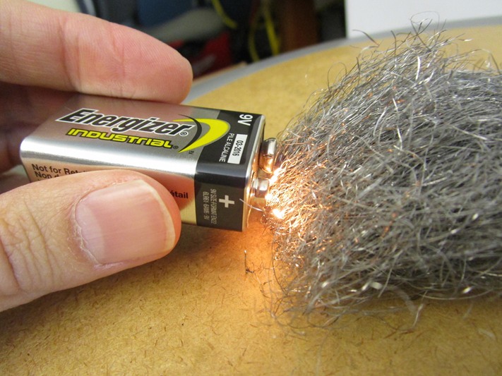
Electrical
Battery and steel wool
Gum wrapper and battery

Slide 17
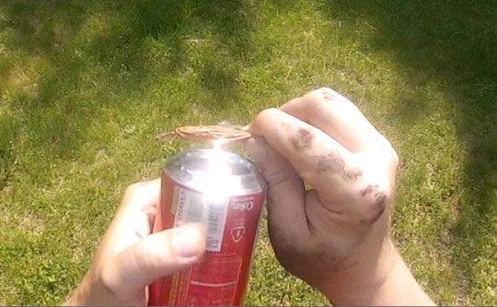
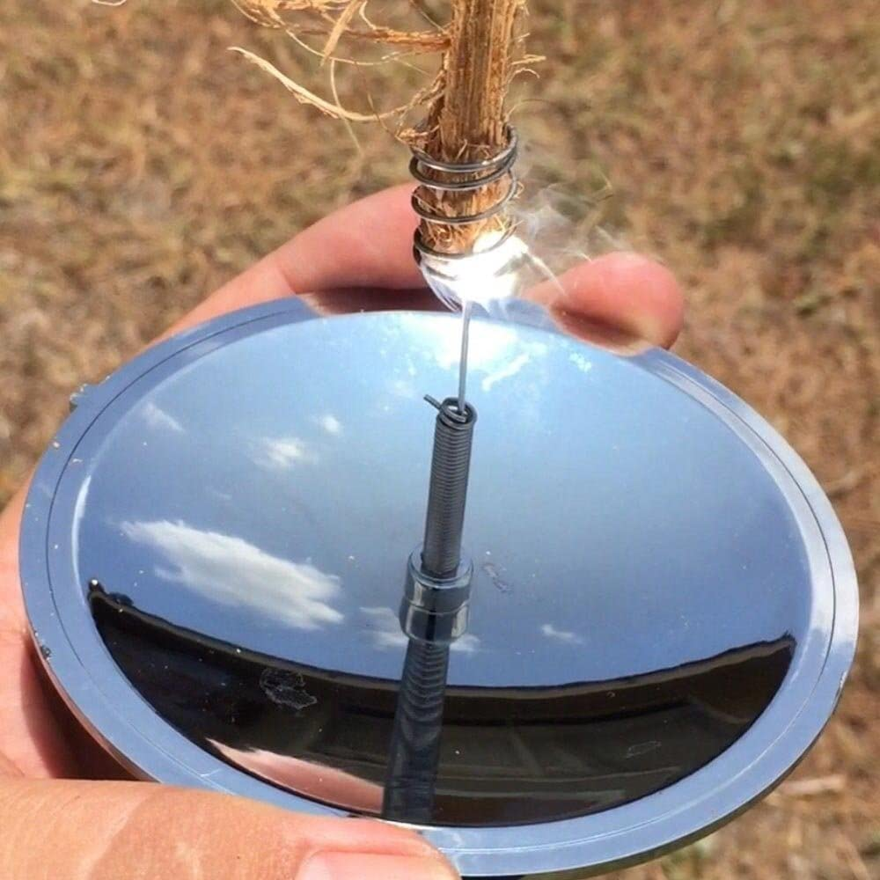
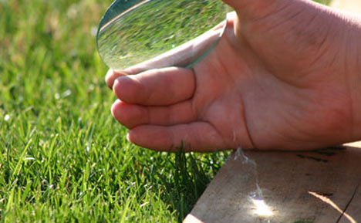
Solar magnifier or reflector

Slide 18
Putting it out
Fires need to be dead cold out
Pour water on the fire
Stir it with a stick and add more water if needed.
By the end you should be able to touch it and feel no heat

Slide 19
Contact Info
This PowerPoint and all videos are located at:
https://www.tf-links.com/uos-fire
My email is: tfew@toofew.net
Phone Number is: 605-415-2809

