Slide 1
Geocaching with Scouts
Travis Few
Scoutmaster Troop 5, Scott AFB IL
Assistant Cubmaster Pack 21, Scott AFB IL

Slide 2
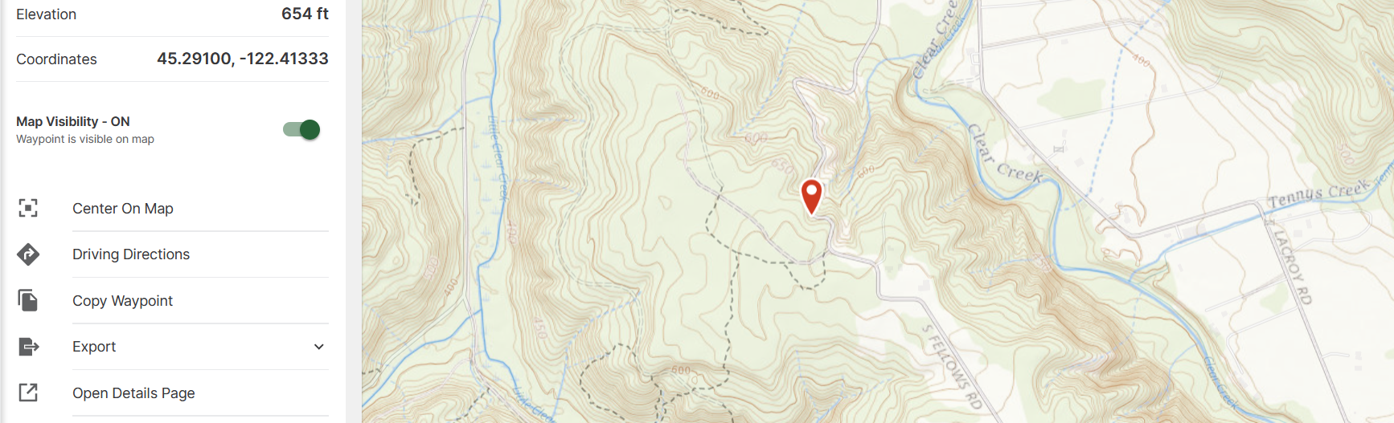
What is Geocaching?
Geocaching is a high-tech treasure hunting game played throughout the world by adventure seekers equipped with GPS devices. The basic idea is to locate hidden containers, called geocaches, outdoors and then share your experiences online. Geocaching is enjoyed by people from all age groups, with a strong sense of community and support for the environment.
Geocaching.com is the world’s largest location-based gaming portal. Started in September, 2000, by GPS enthusiast and web developer Jeremy Irish, the site now hosts more than 5 million geocachers, and more than 1.3 million active caches. Geocaching.com offers an array of features for both novice and avid geocachers. If someone is new to this worldwide activity, Geocaching.com will lead them through all the necessary steps for their first geocaching experience. The site provides an in-depth tutorial for getting started, as well as instructions on finding geocaches.

Slide 3
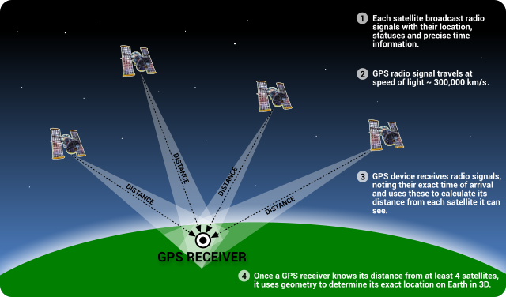
What is GPS?
A navigational system of 24 satellites and multiple ground stations. At least 3 satellites needed to get an accurate location. The more the better. 4 needed for altitude.
You need a receiver to use the system.
Smart Phone – almost everyone has one
Good ones can be had for under a $100
Your car GPS might even work

Slide 4
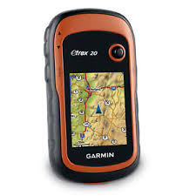
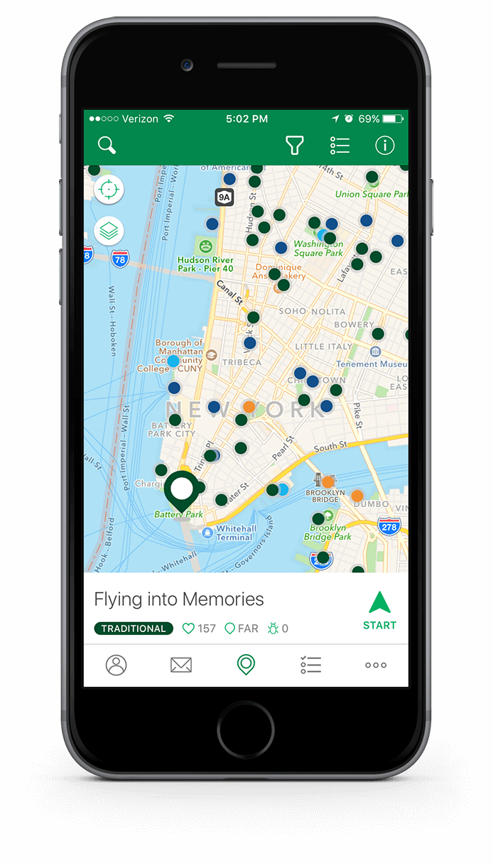
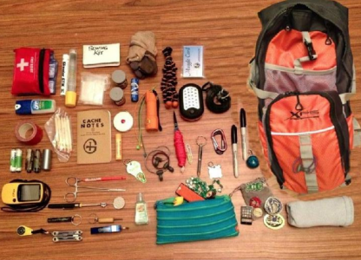
What is needed to go Geocaching?
Cub or Scouts BSA Essentials
GPS Receiver (Dedicated unit or phone)
Writing Utensil
Trinkets

Slide 5
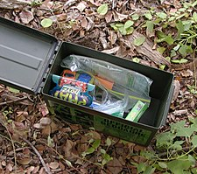
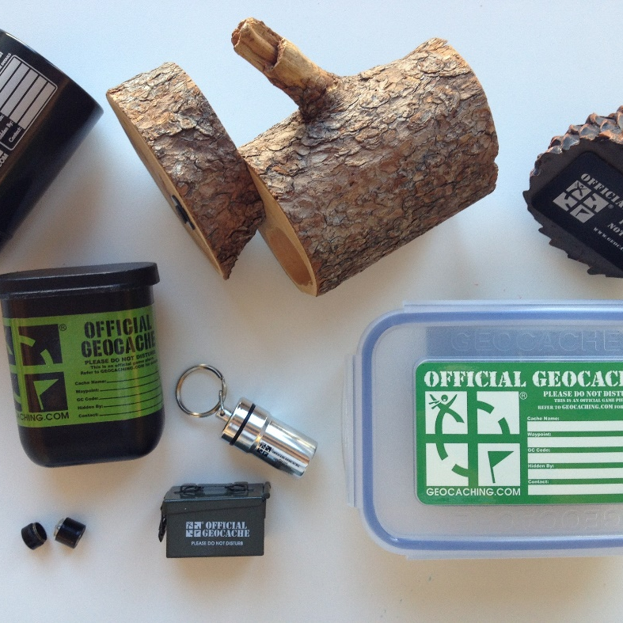
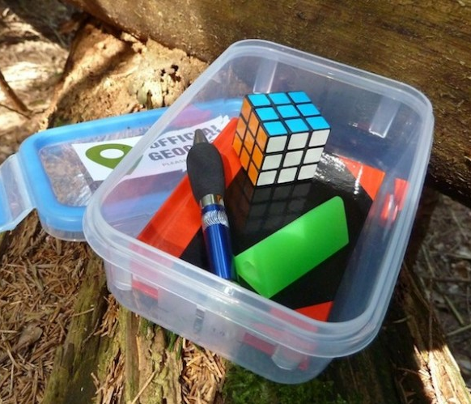
What is a Cache?
Traditional Geocache. These geocaches will be a container at the given coordinates. They size may vary, but at minimum, all of these geocaches will have a logbook. Larger containers may contain items for trade and trackable.

Slide 6
Types of Geocaching.com Caches

Slide 7
Types of Geocaching.com Caches

Slide 8
Types of Geocaching.com Caches

Slide 9
Geocaching with Scouts
Traditional logged caches found on the geocaching.com site
Lots of local parks have caches in them
Some Scout Camps have one near or on them
Hiding a Logged Cache
Must follow the rules and commit to maintaining the cache
Detailed instructions are on geocaching.com
Making your own for the Scouts to find

Slide 10
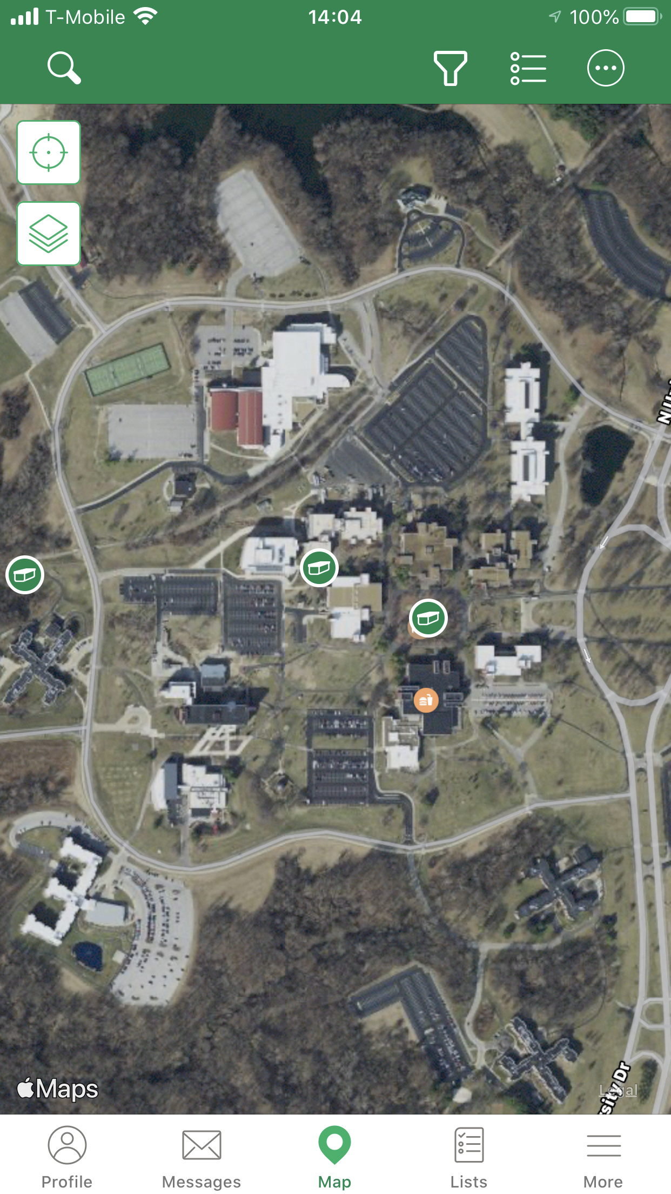
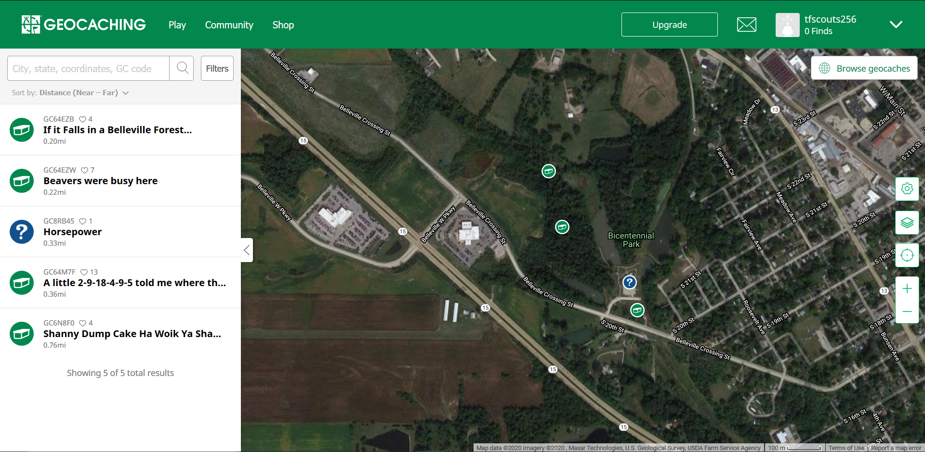
Traditional Caching
www.geocaching.com
Both free and paid accounts ($9.99 for 3 months)

Slide 11
Cache to Eagle program
Cache to Eagle is a partnership between Geoscouting, the BSA, and Geocaching.com to highlight Eagle projects across the nation
Finding a Cache to Eagle Series
Participating BSA local councils will hide 12 caches in their territories. To find them, go to Geocaching.com and choose “Hide and Seek a Cache.” Type in the search term “Cache to Eagle” and your BSA local council name
More Info: http://www.scoutingnews.org/cache-to-eagle/

Slide 12
Hiding your own private Caches
These are private and not listed on Geocaching.com
Hide your own for a great scouting event
Can follow a theme (Scout Law)
Use as a recruitment day activity
This can be done at almost any location
The “caches” can be Traditional caches or an item of significance (plants to ID, Historic location, a snack, ect

Slide 13
Considerations/Setup
A place to hide caches
Check with the owner – some parks/government areas will not allow any caches
Balance the spacing
Too close not as fun/groups can see each other find the next cache
Too far scouts get tired and distracted
Balance the amount
You don’t want to many and over saturate the area
To few and not everyone gets a turn finding
Make caches or choose something as a waypoint
Hide caches and record the coordinates

Slide 14
What tech is needed?
Option 1
Smart phones – parents or leader supplied
Gaia GPS App
Google maps doesn’t work well for this application
A GPX file with the coordinates
Option 2
GPS devices – one per person or den/patrol
To save time preload the coordinates if you can

Slide 15
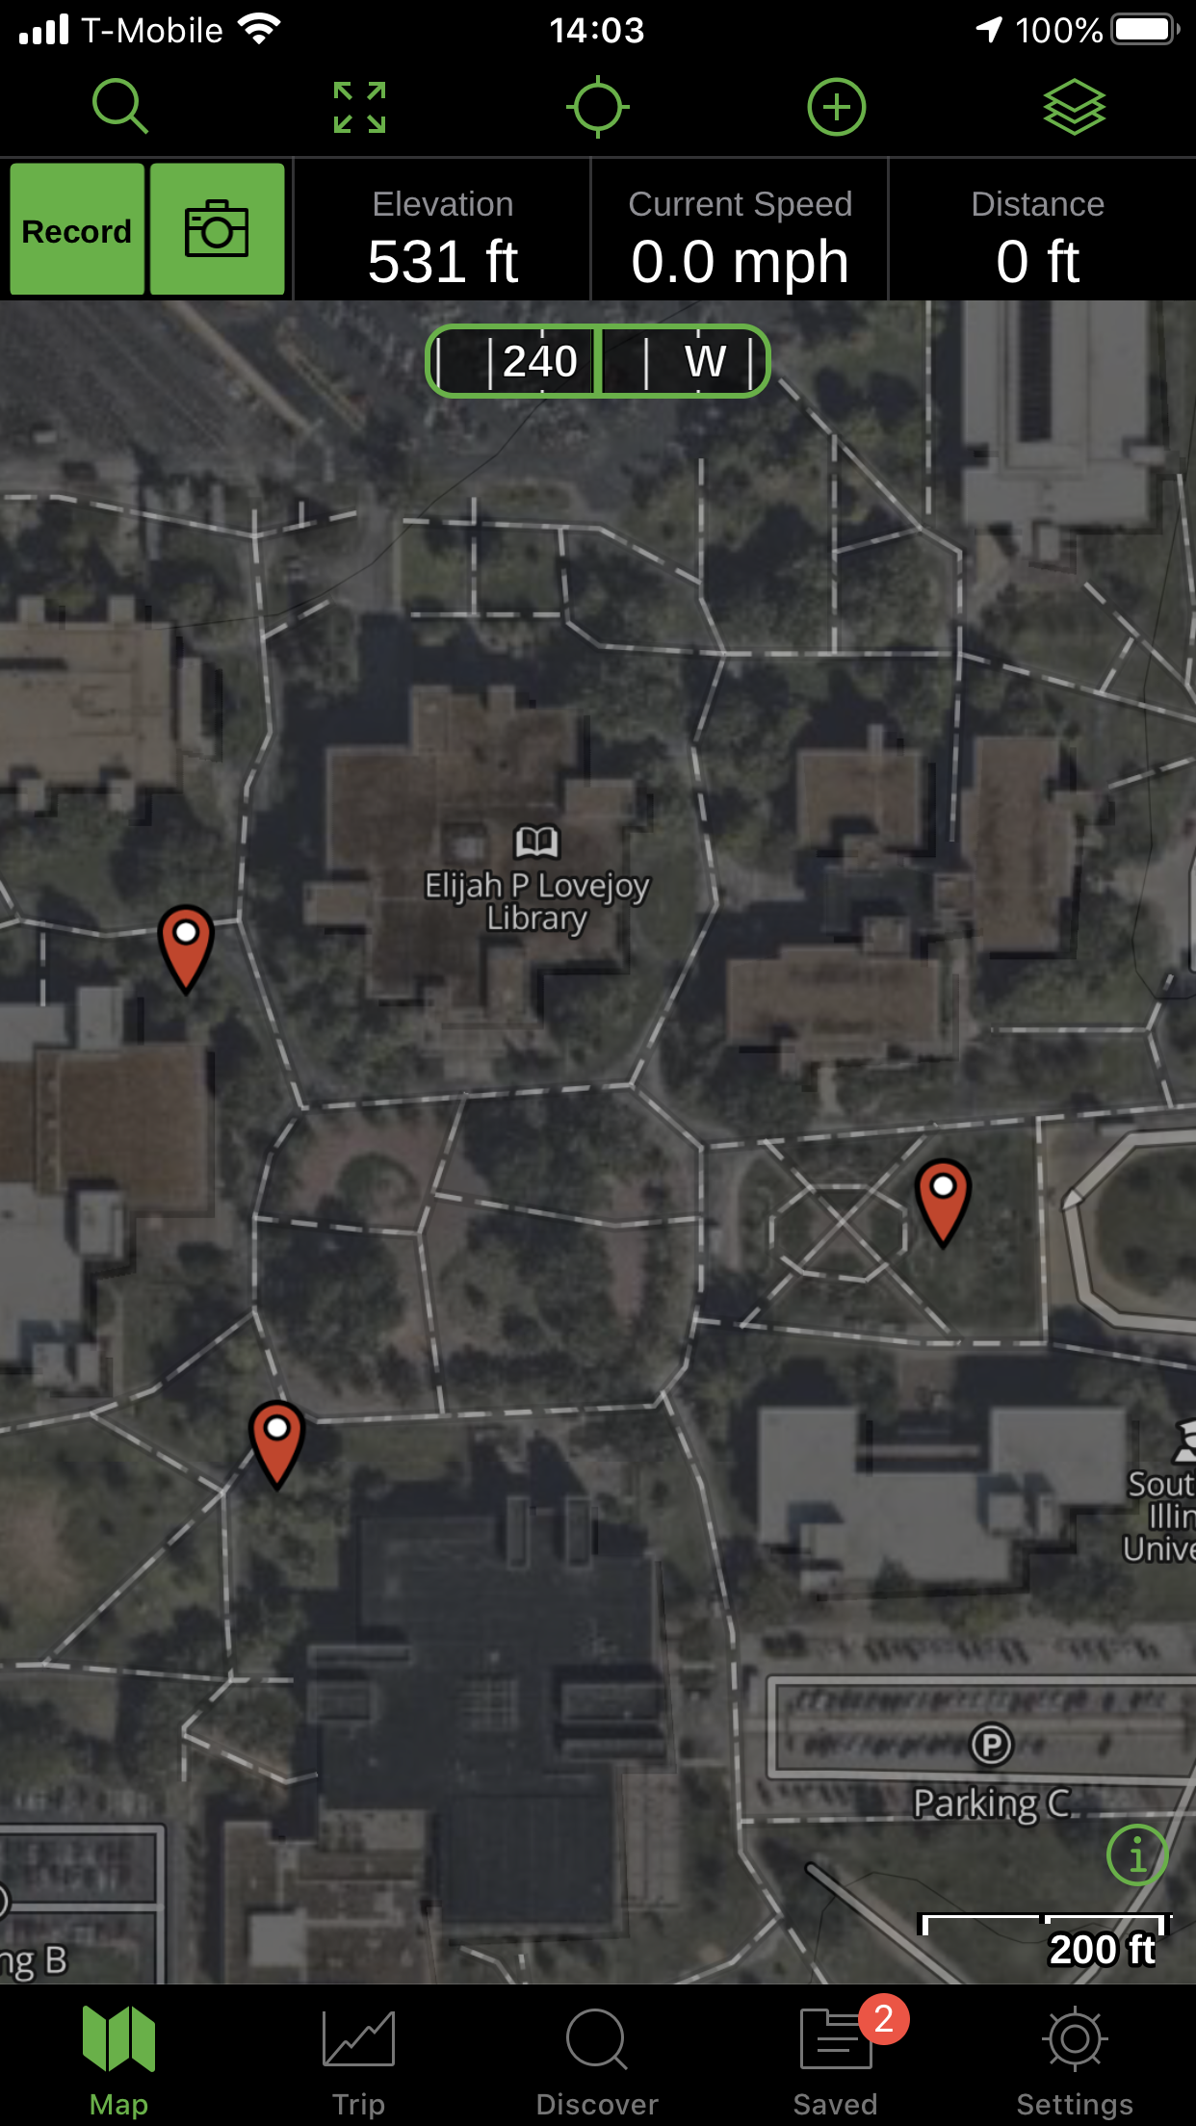
Option 1
Gaia GPS works on both iPhone and Android
Free version work for this
We will be doing this as an activity

Slide 16
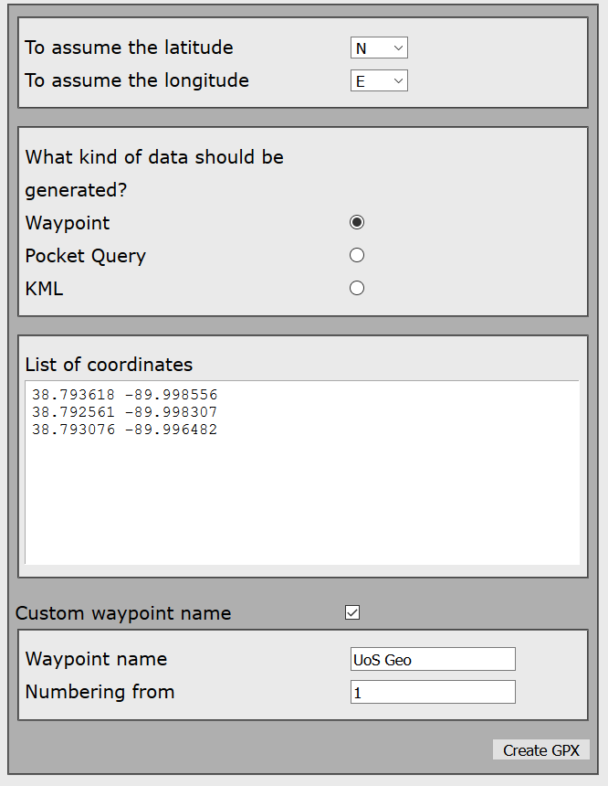
To Make a GPX File
Go to http://www.gcgpx.cz/?lang=en
Fill in your GPS Coordinates and click generate GPX
Tips:
Decimal format is the easiest format to input
Gaia or GPS units have the option to select this format
Name your waypoints something meaningful

Slide 17
Next
You will need to get the file to the person's phone
Text, email, or Dropbox work on both phone types
iPhone instructions found Here
Android instructions found Here
Once they have it loaded, they can select a waypoint and find the cache

Slide 18
Option 2
Step 1 hide the caches and record the location
Step 2 input the coordinates to each unit
Step 3 let the scouts find the caches

Slide 19
Time to try it out
For those that want to try option 1
If you haven’t yet please install Gaia GPS
Download the GPX file at geo.travisfew.com
And follow the instructions on the next couple of slides
For option 2 come up and grab a GPS unit
We can also do a cache from Geocaching.com
If you have the app and an account use the map to look at the SIUE campus and find “Green!”

Slide 20
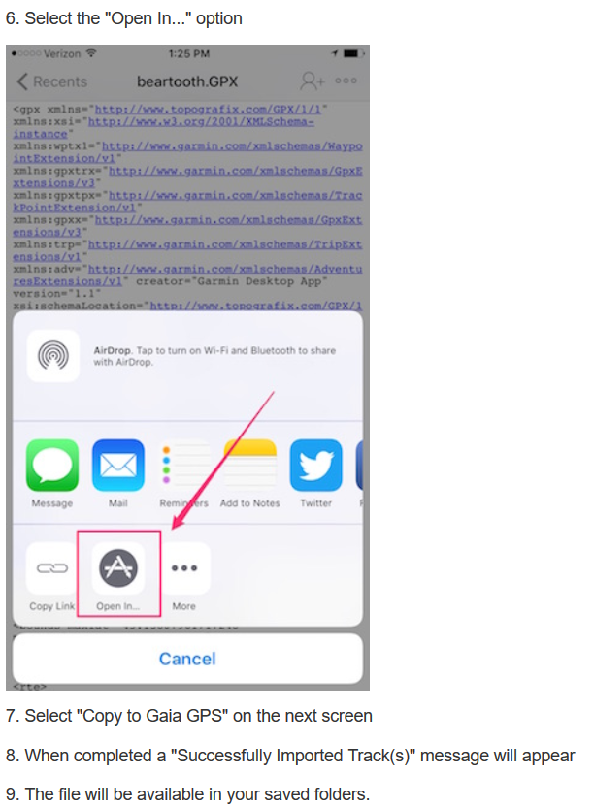
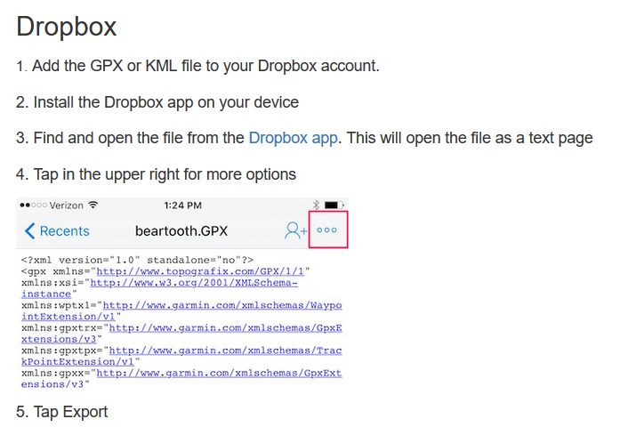
iPhone Instructions
Found gpxiphone.travisfew.com

Slide 21
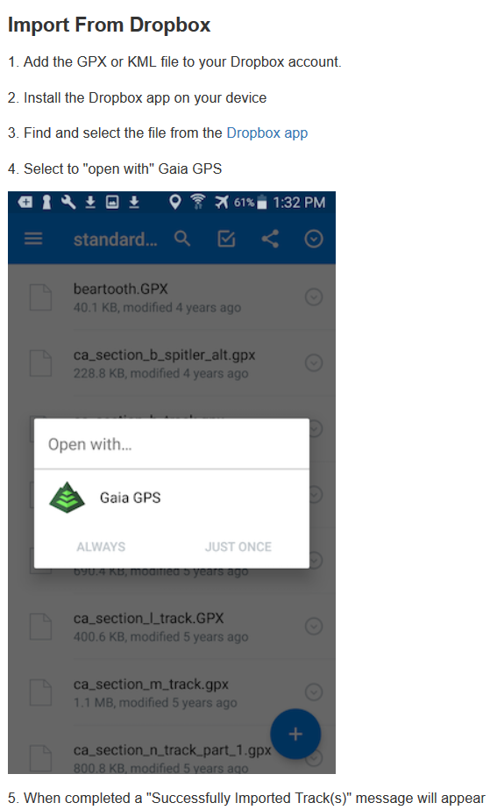
Android Instructions
Found gpxandroid.travisfew.com

Slide 22
Links
Questions email me at tfew@toofew.net
www.geocaching.com
GPX creating http://www.gcgpx.cz/?lang=en
GPX importing
iPhone instructions found Here
Android instructions found Here
Cache to Eagle http://www.scoutingnews.org/cache-to-eagle/

