Slide 1
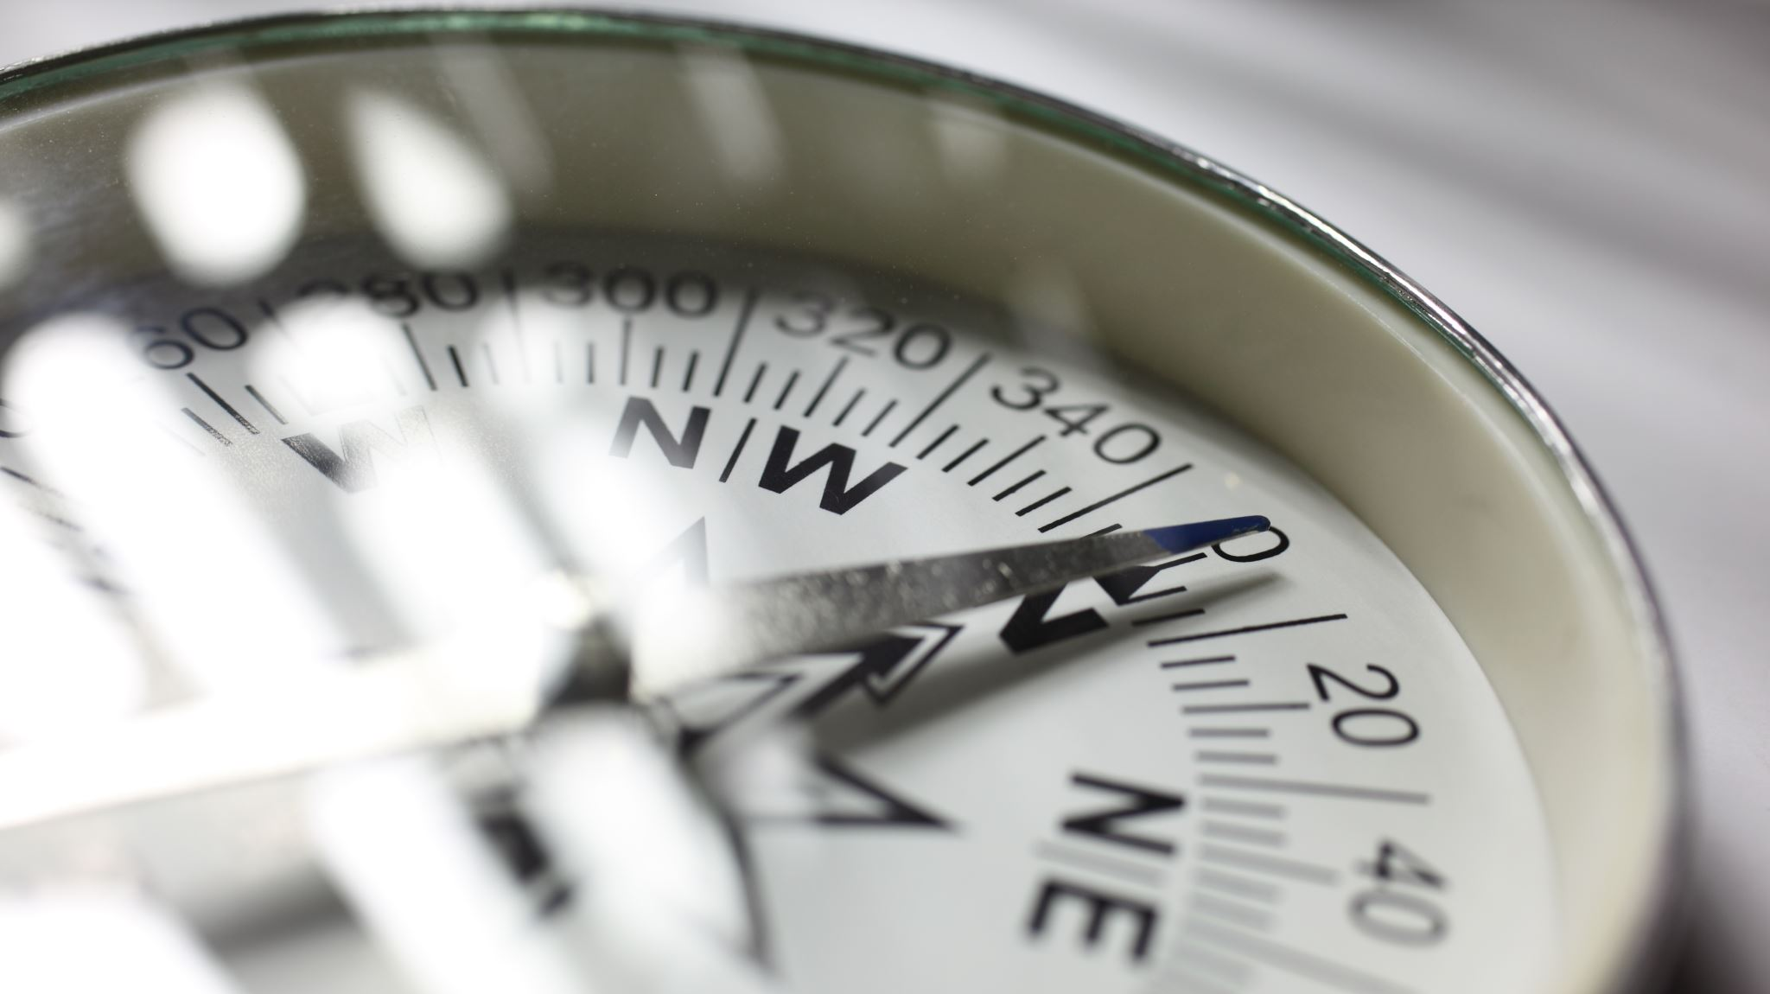
Map and Compass
Travis Few
Scoutmaster Troop 5, Scott AFB
Assistant Cubmaster Pack 21, Scott AFB

Slide 2
Why a Map and Compass
One of the Ten Essentials
Map and Compass
Why not rely on a GPS?
Subject to
Signal being blocked (Weather and other reasons)
Batteries
Can be broken/get wet

Slide 3
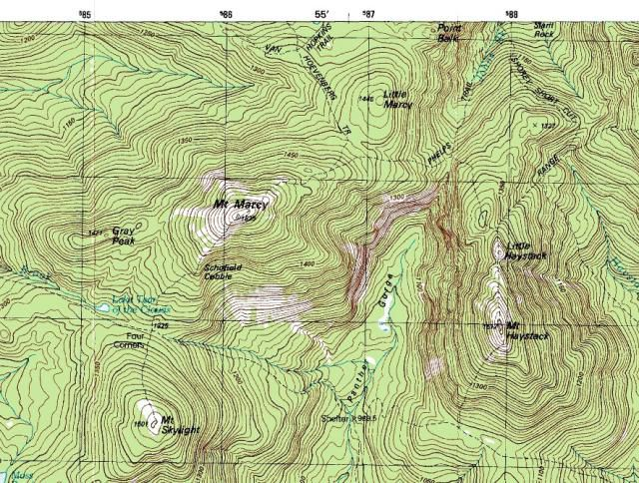
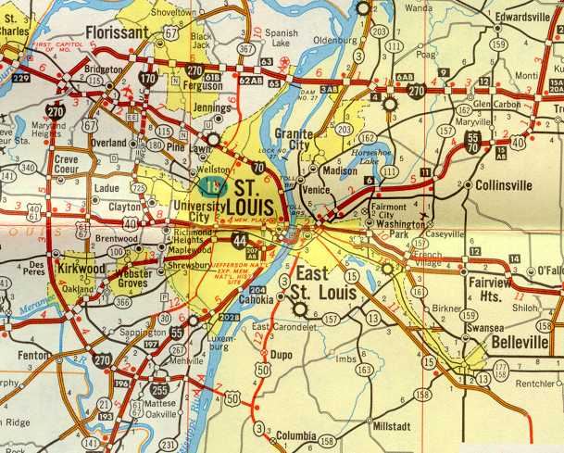
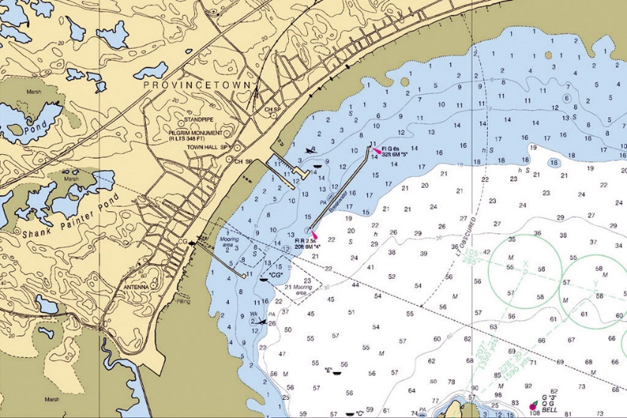
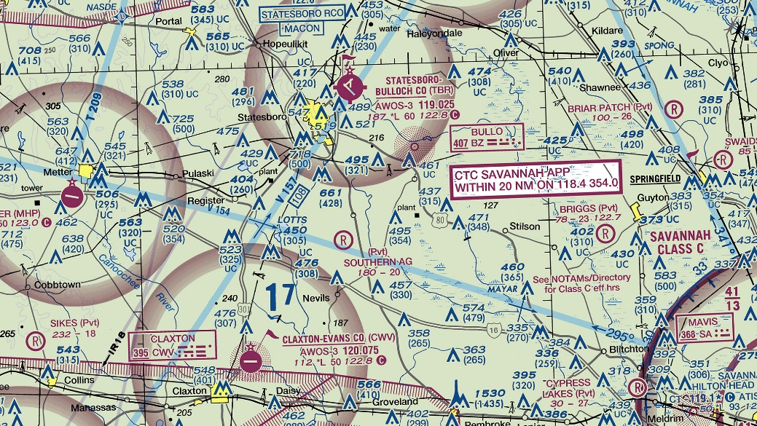
The Map
Many kinds of maps
Road maps like the AAA
Aviation Maps
Nautical Maps
US Geological Survey (USGS) maps
USGS Maps are what we use most for hiking
1” = 24,000’
Or 1” = 25,000’

Slide 4
Legend
Somewhere on the map that describes all the information used on that map
Symbols
Scale of Map
Distance Scale
Compass Rose
Date of Data

Slide 5
Legend
Map info and Datum
Distance and Scale
Compass Rose with Declination Date

Slide 6
North?
How many norths are there?
Answer: 3
Magnetic North – What your compass shows
True North – A direct line between you and the North Pole
Grid North – The North represented on the map
The difference between them is declination
This is found in the legend on most maps
It should be checked as the magnetic pole moves
Current positions declination is 0
www.ngdc.noaa.gov

Slide 7
A word about Datum
A geodetic datum is a tool used to define the shape and size of the earth, as well as the reference point for the various coordinate systems used in mapping the earth.
Throughout time, hundreds of different datums have been used - each one changing over time.
World Geodetic System (WGS): several different datums that have been in use throughout the years WGS 84, 72, 70, and 60. The WGS 84 is current the one
North American Datum 1983 (NAD 83) is the official horizontal datum for use in North and Central American
NAD 83 was NAD 27, a horizontal datum constructed in 1927

Slide 8
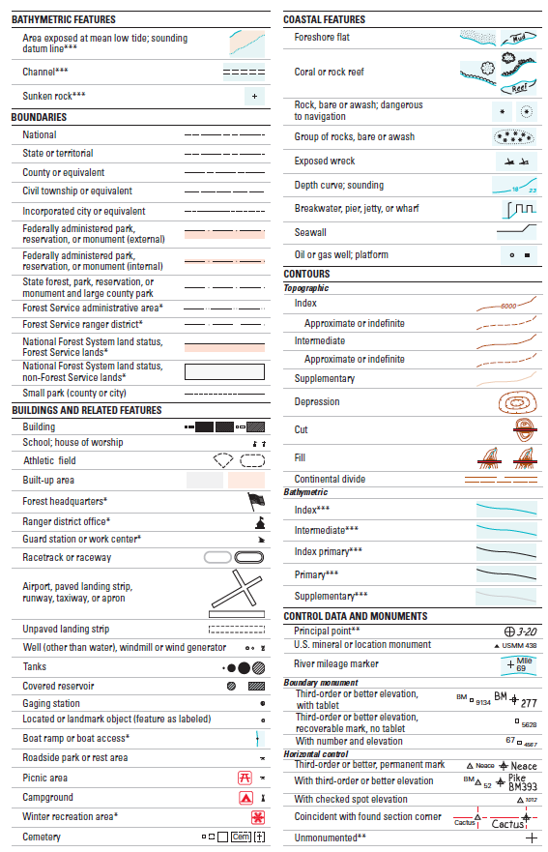
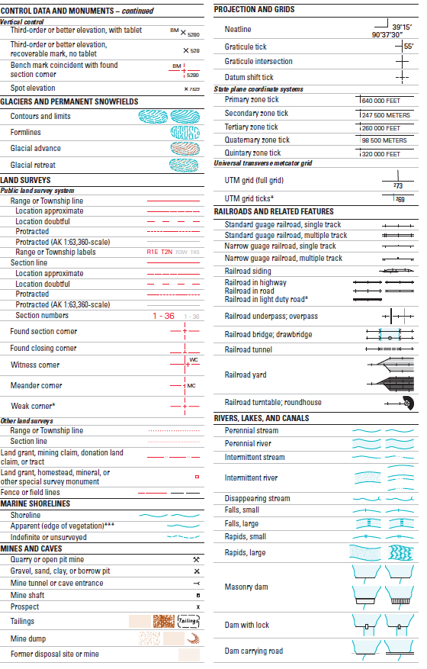
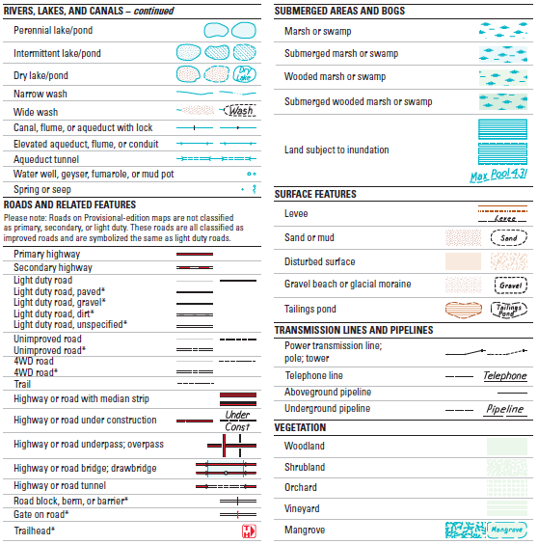
The Map (Symbols)

Slide 9
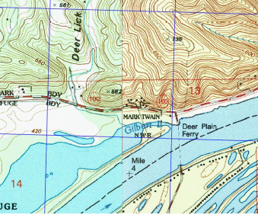
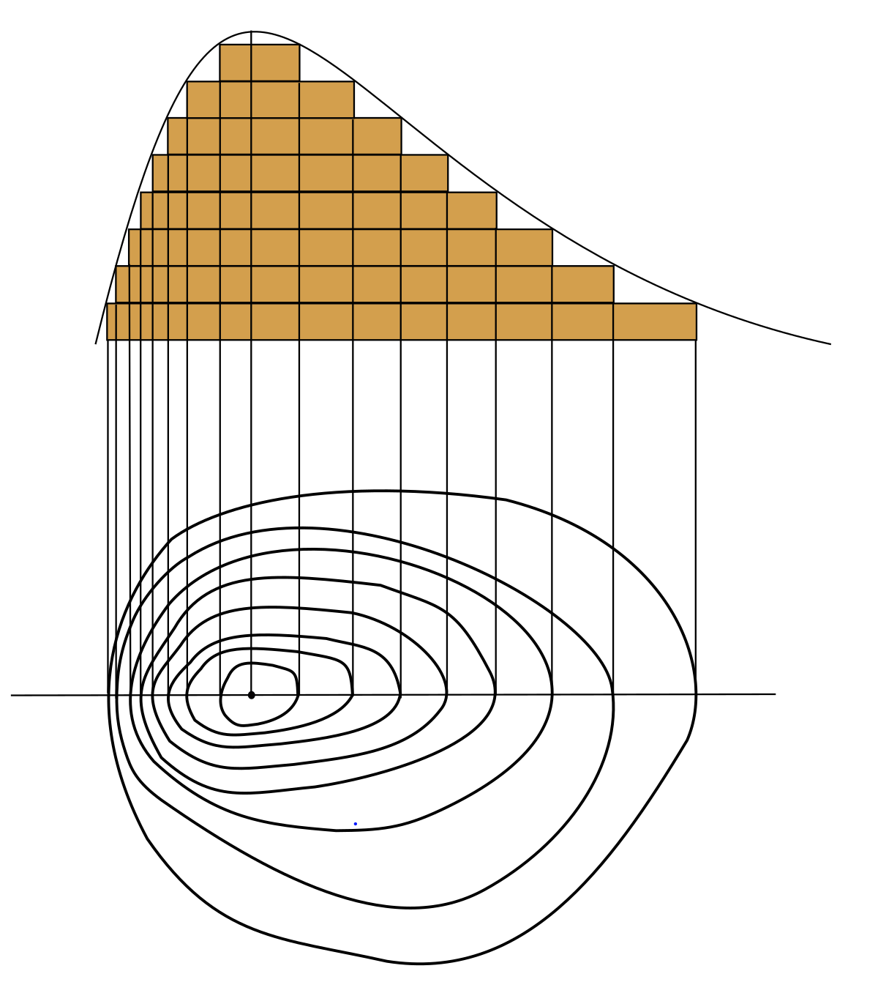
Contour Lines
Elevation
Landforms
This map has 10ft intervals
Flat
Steep

Slide 10
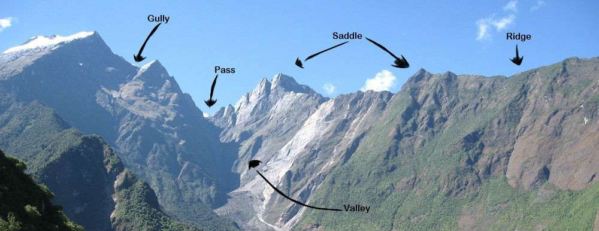
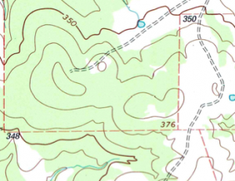
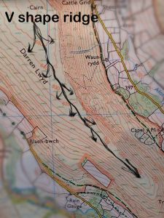
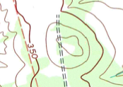
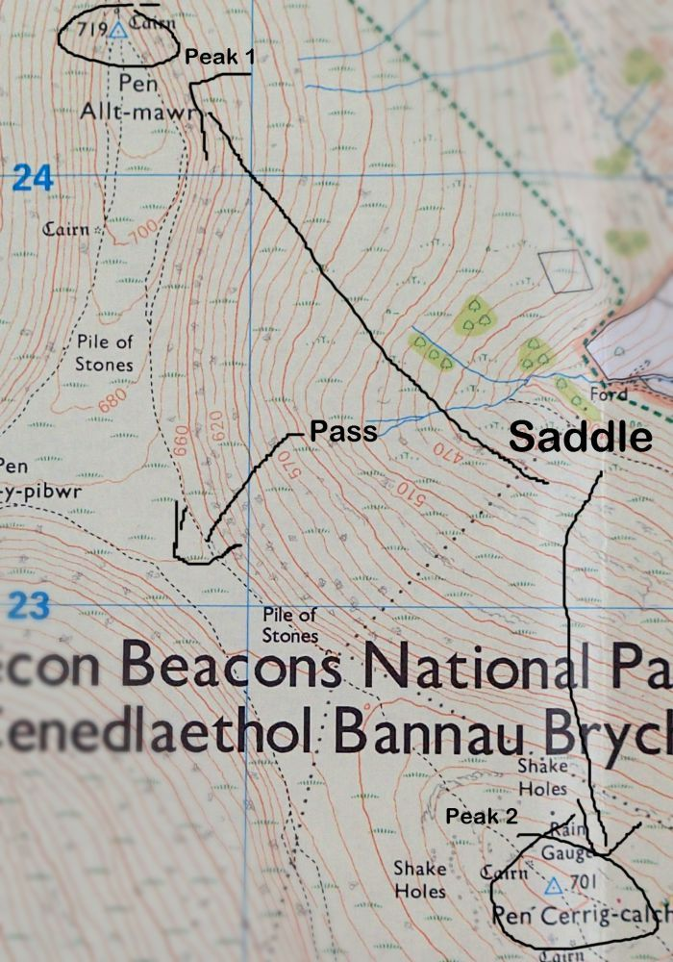
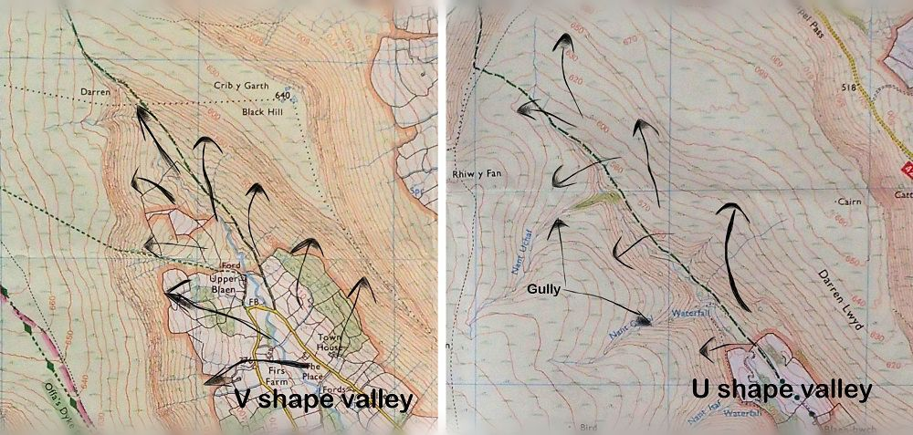

Slide 11
Coordinates Systems
Coordinates
Determine a position on the map
UTM
Lat/Long
MGRS

Slide 12
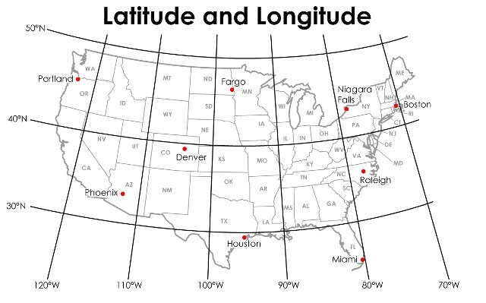
Lat/Long
It’s the one everyone has heard of
Not always the easiest to work
Latitude (Think ladder)
Has 90º
00º at Equator
Measured North - South
Longitude (Think long way around)
Has 180º
000º at Greenwich England
Measured East – West
If we were at SIUE we would be sitting on
90º Longitude

Slide 13
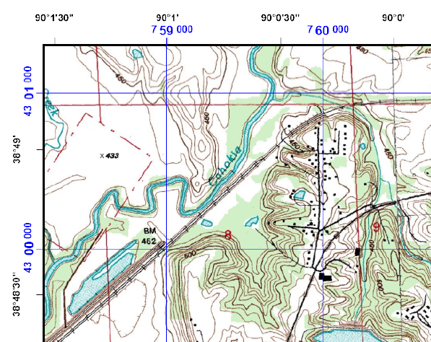
Lat/Long
Longitude
Latitude

Slide 14
The Map
90º00.0300’ or 90º00’30” W
Latitude and Longitude are measured in Degrees º, minutes ‘, seconds”
Can also be measured as Degreesº, Minutes ‘.000 or
Degreesº.000
Each Degree, º, is divided into 60 Minutes, ‘
Each Minute , ‘ , is divided into 60 Seconds, “
38º48.300’ or 38º48’30” N

Slide 15
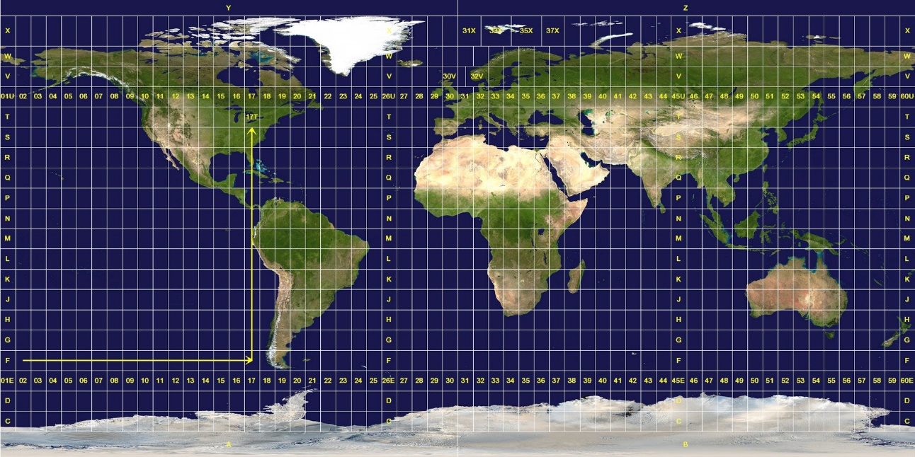
UTM/MGRS
Universal Transverse Mercator (UTM)
The UTM system divides the Earth into 60 zones, each 6° of longitude in width. Zone 1 covers longitude 180° to 174° W; zone numbering increases eastward to zone 60, which covers longitude 174°E to 180°. The polar regions south of 80°S and north of 84°N are excluded
Military Grid Reference System (MGRS)
The MGRS is derived from the UTM, but uses a different
labeling convention
MGRS is used for the entire earth

Slide 16
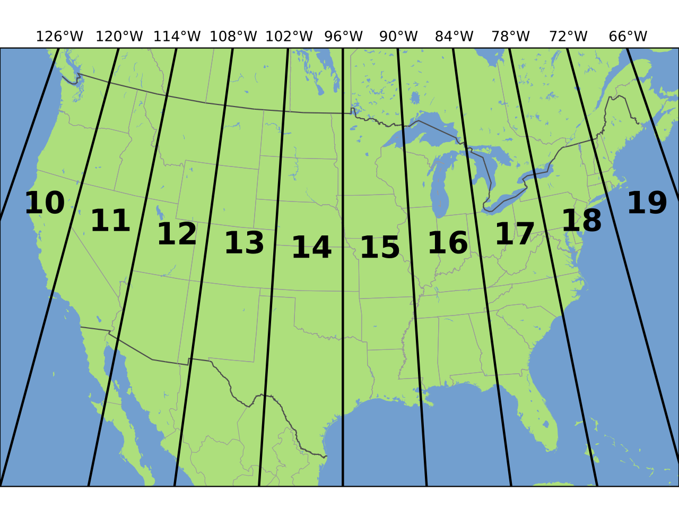
UTM/MGRS
We are in 15S
UTM – 15S 0713340 4316990
MGRS – 15S YD 13340 16990

Slide 17
UTM vs MGRS Formats
1,000 km square
100 km square
10 km square
1 km square
100 m square
10 m square
1 m square
1
4
9
3
3
1
9
0
15S
0
4
15S
YD
1
0
6
7
3
3
0
4
3
1
6
9
9
0
UTM
MGRS

Slide 18
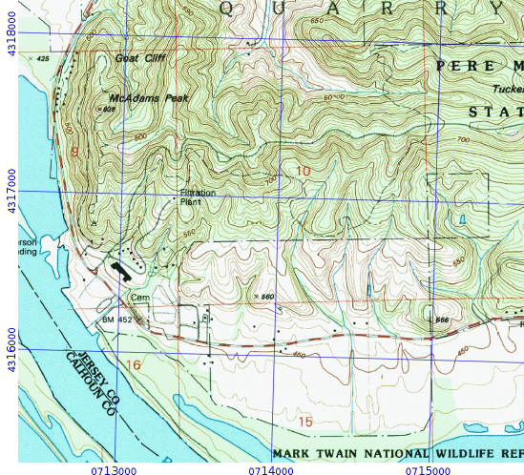
Understanding Grid Squares
In the door up the stairs or left to right and up
We want to know what square the star is in
In the door
Up the stairs
Starting corner of the grid
The square

Slide 19
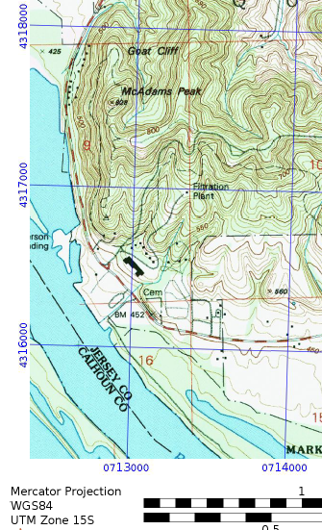
UTM Coordinates for The star
15S 0713 340 4316 990

Slide 20
UTM Exercise
What are the coordinates for the building north of the “b” in Tucker Knob?

Slide 21
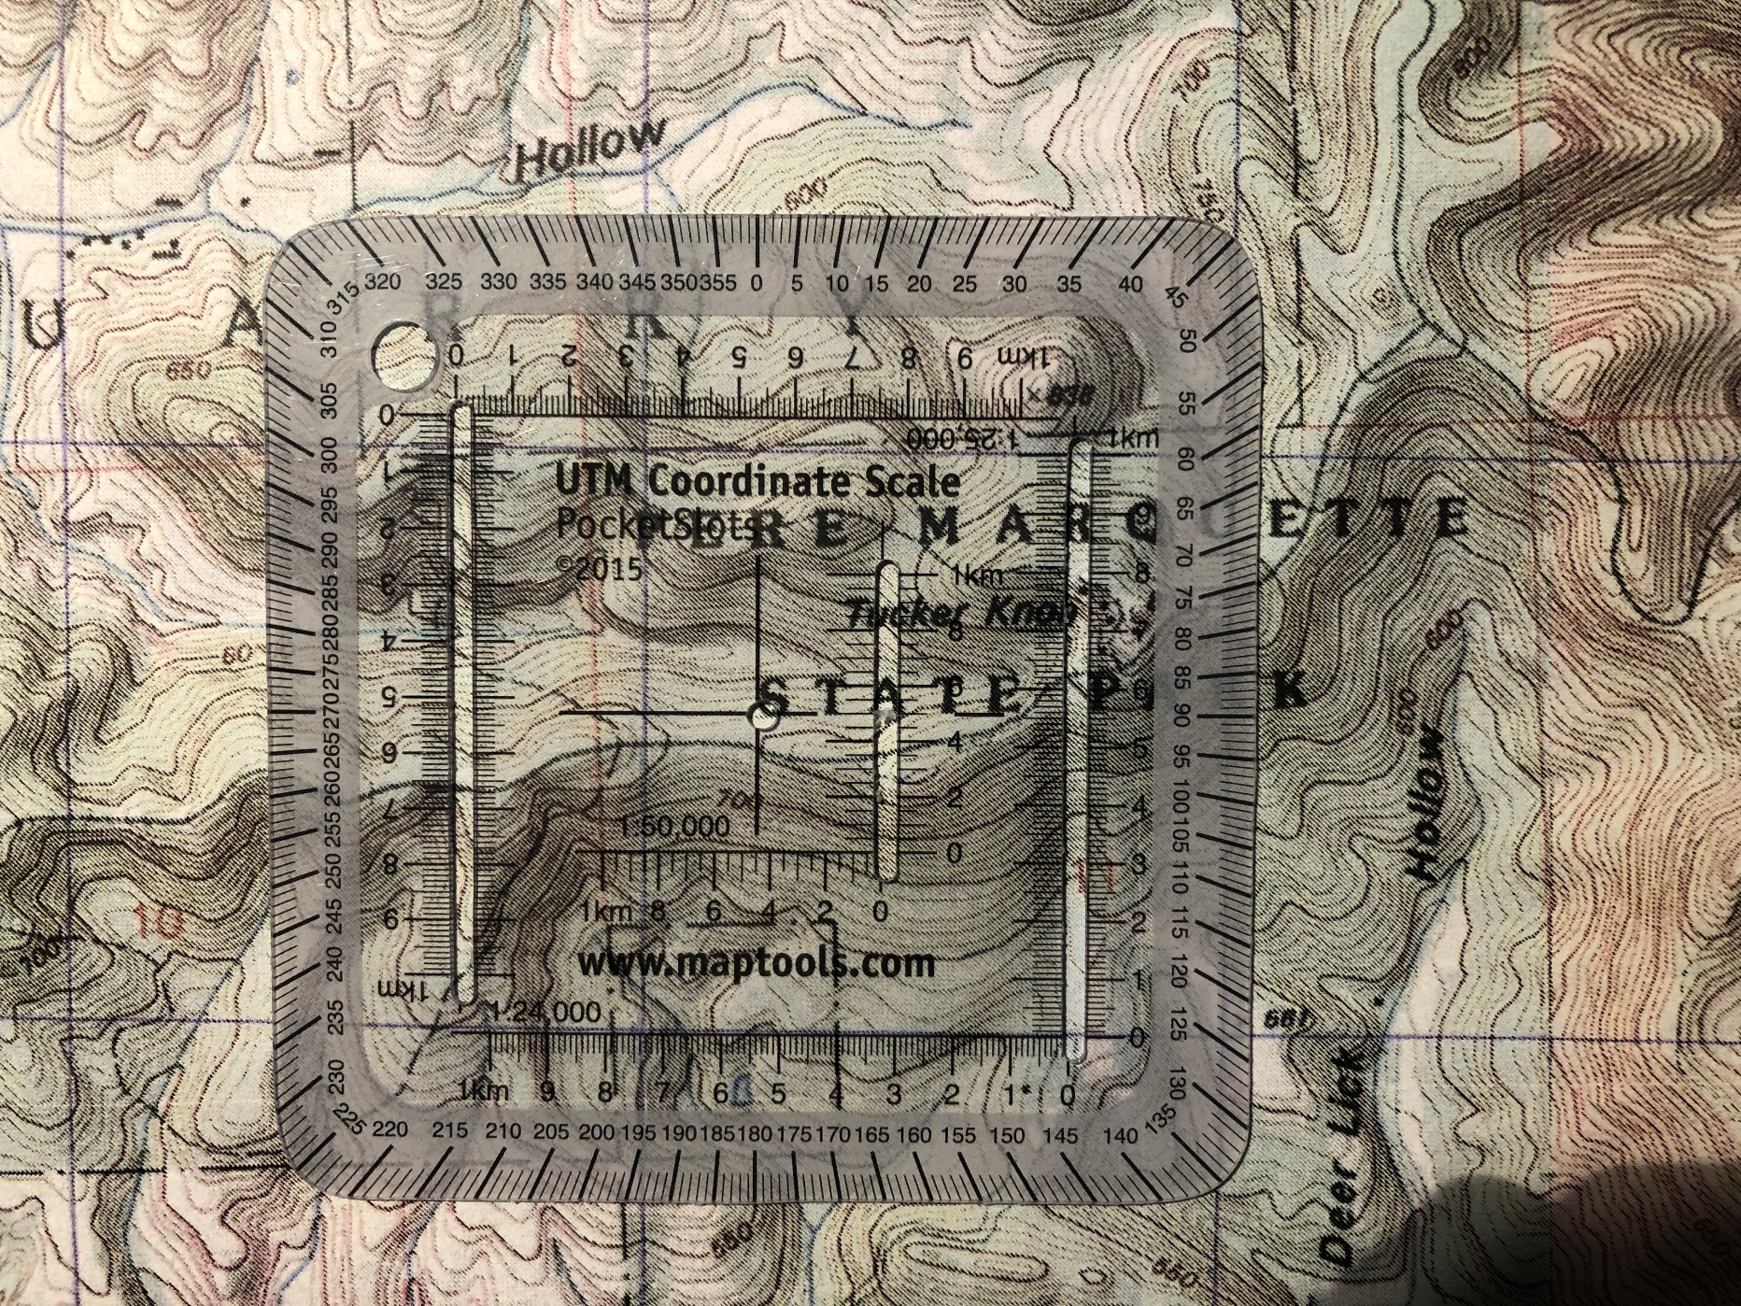
UTM Exercise
15S 0715750 4317780

Slide 22
UTM Exercise
What is at 15S 0713320 4316990

Slide 23
Compass
What’s it Good for?
Compass by itself to walk in a straight line on a heading or barring
With a Map
Find where you are (Point)
Find where you’re going (Heading or Barring)
Find where you have been (Back Azimuth)

Slide 24
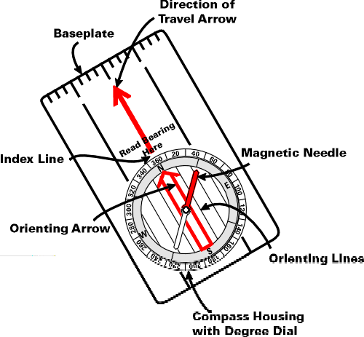
The Basic Compass Features
The compass consists of a magnetized metal needle that floats on a
pivot point. The needle orients to the magnetic field lines of the earth.
The basic orienteering compass is composed of the following parts: Base plate Straight edge and ruler Direction of travel arrow Compass housing with 360 degree markings North label Index line Orienting arrow Magnetic needle-NORTH end is ALWAYS red)
NOTE! There are many different types of compasses and some are very specific for certain tasks. One that has declination adjustment, called an Orienteering compass, is very useful.

Slide 25
Orienteering
Compass
Suunto MC-2
Orienteering
Compass
Suunto A-10
Clinometer
Compass
Suunto Tandem
Lensatic
Compass
Cammenga M27

Slide 26
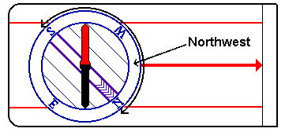
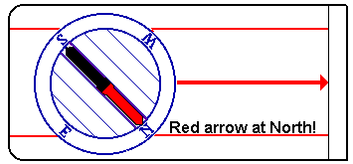
Using a Compass WITHOUT a Map
Lets go Northwest
Locate Northwest on the compass housing
Then you turn the compass housing so that northwest on the housing comes exactly there where the large direction of travel-arrow meets the housing.
Hold the compass in your hand and make sure it is flat, so that the compass needle can turn.
Compass housing
Now turn yourself, your hand, the entire compass, just make sure the compass housing doesn't turn, and turn it until the RED part of the compass needle is aligned with the lines inside the compass housing.
Be careful! It is extremely important that the red, north part of the compass needle points at north in the compass housing. If south points at north, you would walk off in the exact opposite direction.
This is a very common mistake with beginners.

Slide 27
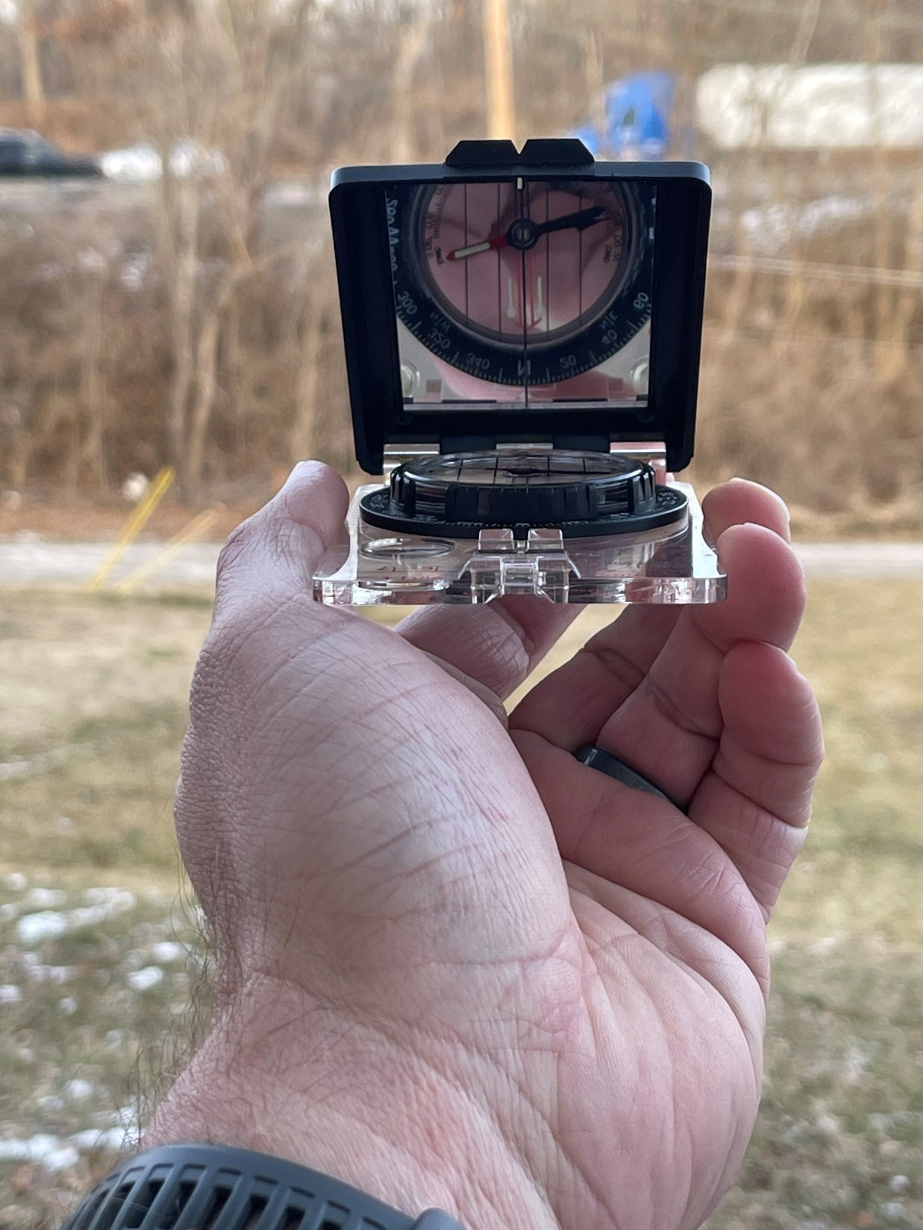
Line up the compass our line of sight and the distant object
Then we want to turn the bezel till “red is in the shed”

Slide 28
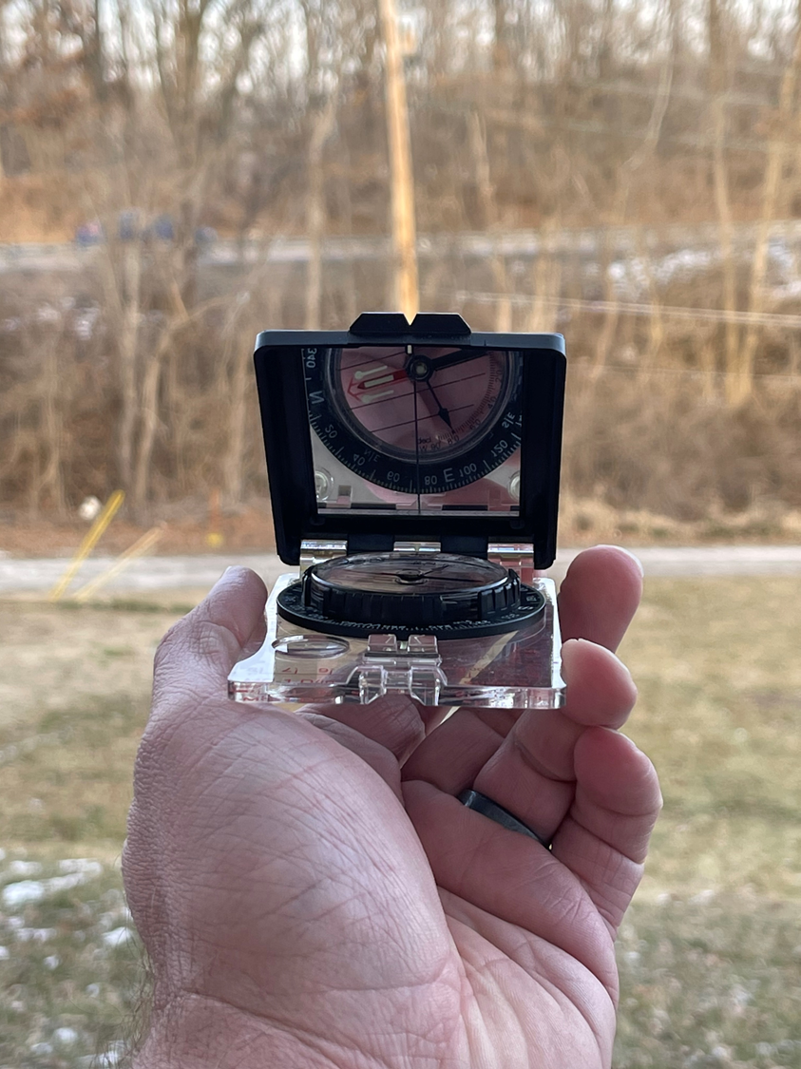
Now that the bezel has been turned to line up north and “red is in the shed” we have our barring indicated

Slide 29
Our heading or barring is 76°

Slide 30
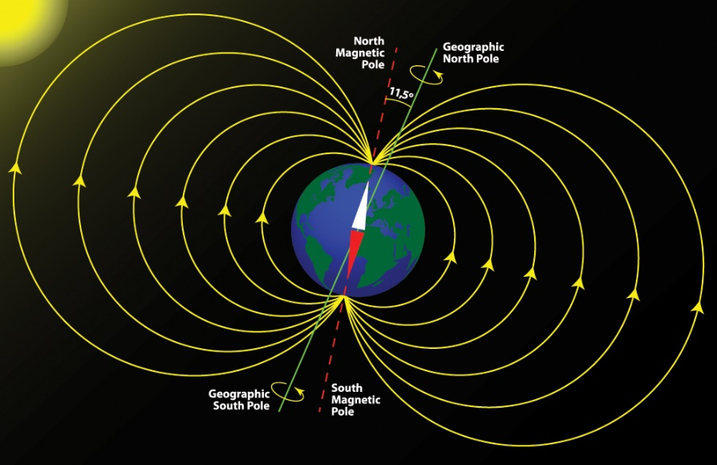
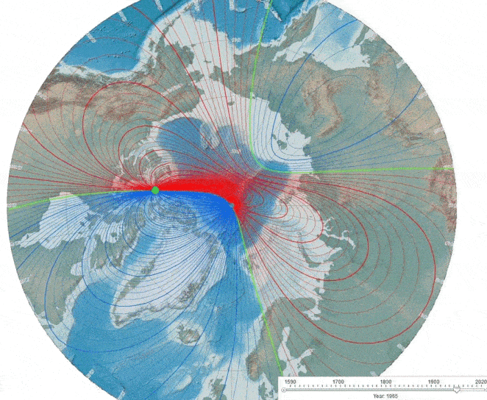
The Map and Compass Together as a Tool
To use the map and the compass together you must first get them looking at the same North
Map Aligned with Grid North
Compass aligned with Magnetic North
Difference is caused by magnetic fields of the Earth
You must “Orient” the map
Align the map with Magnetic North or
Align the compass with Grid North

Slide 31
The Map and Compass Together as a Tool
Map may have a Compass “Rose” as on our map
Or it may simply tell you what the deviation is

Slide 32
The Map and Compass Together as a Tool
Orienting the Map with the Compass Rose
Line up the edge of your compass (which reads Mag N) with the Magnetic North, MN, line on the compass rose

Slide 33
The Map and Compass Together as a Tool
Now rotate the map until the index lines up with the North needle
Now your map is oriented to Magnetic North and can be used with your compass

Slide 34
The Map and Compass Together as a Tool
Orienting the Map without the Compass Rose
Difference between Magnetic North (compass) and True North (Map) is given as a Deviation or Declination value East or West
Note the difference and adjust the dial on your compass so the North reference is now True North
Rule is:
“East is Least”
Subtract Deviation from 360º
“West is Best”
Add Deviation to 360º

Slide 35
The Map and Compass Together as a Tool
“East is Least”
Subtract 13º East Deviation from 360º
347º
Set 347º on the top of your compass dial
347
360
347
360
Declination = 13º E

Slide 36
The Map and Compass Together as a Tool
Now align the edge of the compass with any North-South line on the map
The edge of the map or a line of longitude.
OR
347
360
347
360
Declination = 13º E

Slide 37
The Map and Compass Together as a Tool
Rotate the map and compass until the needle is aligned with the index set at 347º
Declination = 13º E
347
360
OR
347
360

Slide 38
The Map and Compass Together as a Tool
To determine your location, look for a prominent feature you can match to the map.
Take your Compass and point the index at the feature.
190
360
Now rotate your dial until 360º is aligned with the North needle
The heading lined up with the index is your bearing to that feature.
In this example - 190º

Slide 39
The Map and Compass Together as a Tool
Note that bearing
Now do the same thing with another known feature on the map
In this example 345º
345
360

Slide 40
The Map and Compass Together as a Tool
Bearings to different features give your approximate location

Slide 41
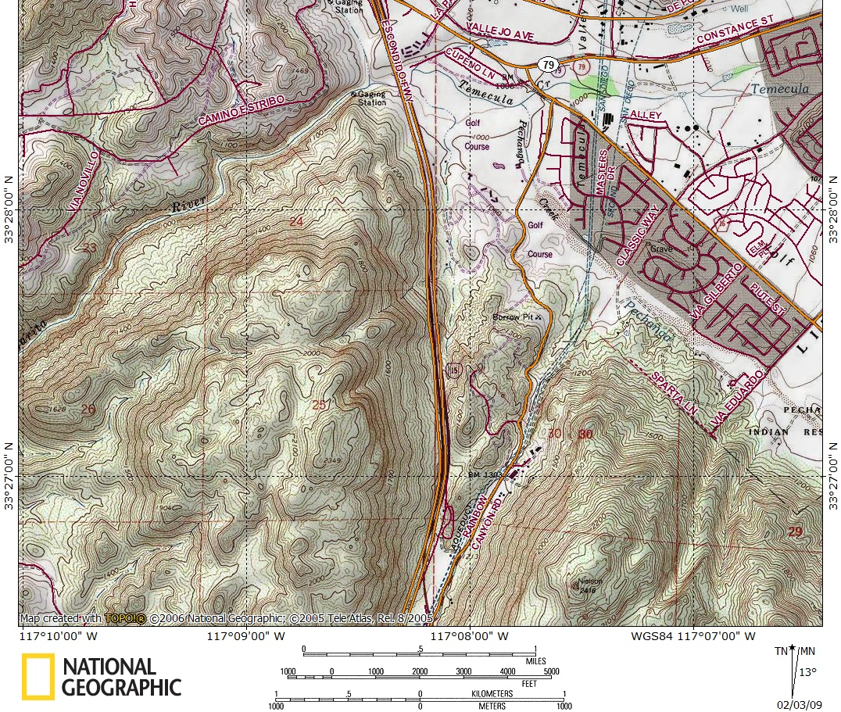
The Map and Compass Together as a Tool
Now you can use this location to get a heading off the map to where you might want to go
For example, the heading from this location to the mine is approximately 165º
360
165

