Slide 1
Raspberry Pi: Coding

Slide 2
whoami
Travis Few
19 years USAF
10 years EOD
9 in Cybersecurity
I enjoy making devices the fill a need

Slide 3
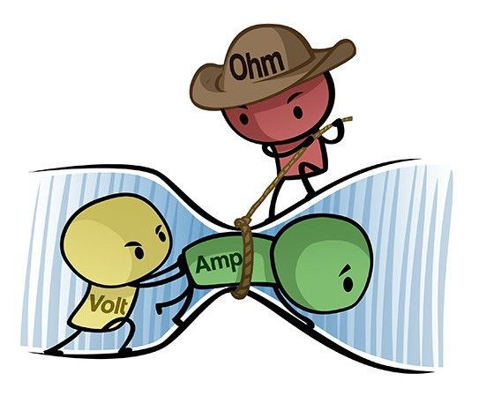

Slide 4
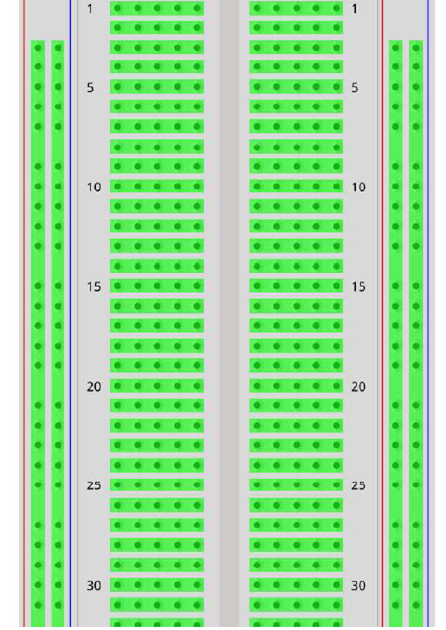
Breadboard Components
The green lines in this image show which sets of holes are electrically connected
Vertical connections: Are typically used for power distribution and marked with red and blue or black lines
Horizontal connections: Each row of five pins is isolated from the rest of the breadboard

Slide 5
Breadboard

Slide 6
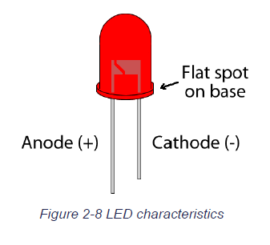
LED
Light Emitting Diode
Long leg is the Anode or positive side
Short leg is the Cathode or negative side
LEDs are polarized and can only be installed in one direction

Slide 7
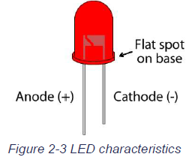
LIGHT EMITTING DIODE (LED)
Light-emitting diodes (LEDs) are a special type of diode that converts electricity into light.
Each LED has two wires or leads. The short side is the negative side the long side is positive
Unlike a resistor they must be aligned correctly electricity flows from positive to negative

Slide 8
Adding in the LED Short leg towards the bottom
Short leg

Slide 9
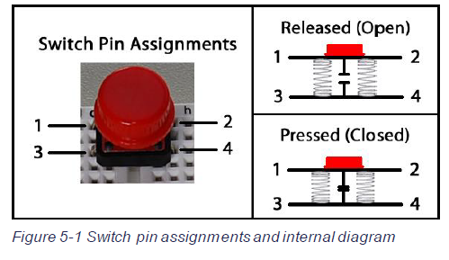
Switch basics

Slide 10
Adding switches Make sure they span the middle

Slide 11
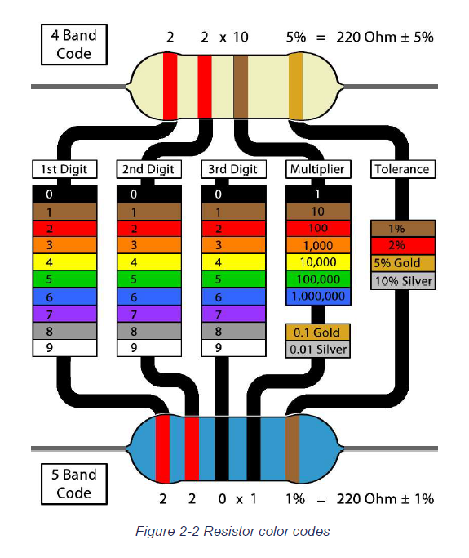
CALCULATING RESISTANCE VALUE
Resistors are marked with colored bands which indicate their internal resistance value

Slide 12
CALCULATING RESISTANCE VALUE
To read the value of a resistor, first determine four-digit code or the five-digit code.

Slide 13
Adding the resistors

Slide 14
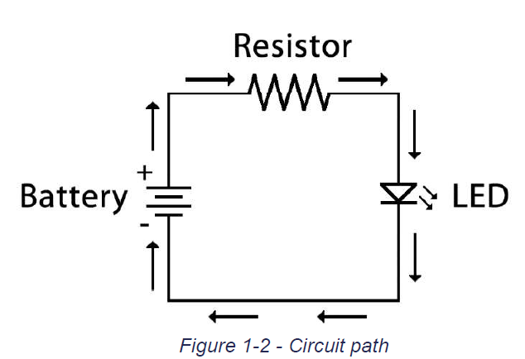
A basic circuit

Slide 15
Adding the wires

Slide 16
Don’t Short circuit

Slide 17
Python and MicroPython
Python is a high-level, general-purpose programming language
It has become the one of the most used languages from IoT to Hacking
Python is an object-oriented programming language, and it contains modules of a standard library
MicroPython is also an object-oriented programming language, but it contains only a subset of all the standard library modules in Python. It is used for developing desktop and cloud applications.

Slide 18
microPython
First, we declare our imports
Don’t type out what’s in yellow those are comments to explain what is happening

Slide 19
microPython
We then declare some of our variables

Slide 20
microPython
We declare a variable for a function
We then use that variable to set a wait time

Slide 21
microPython

Slide 22
microPython

Slide 23
microPython

Slide 24
microPython

Slide 25
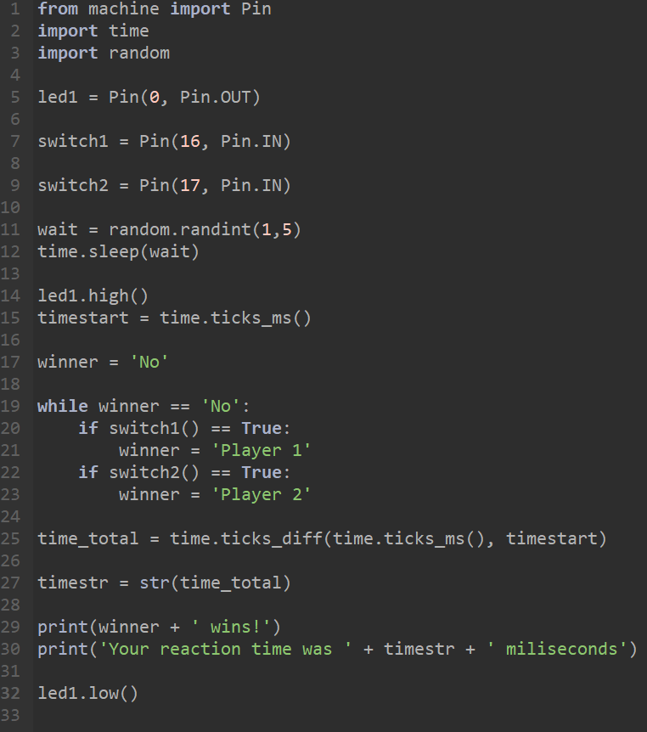
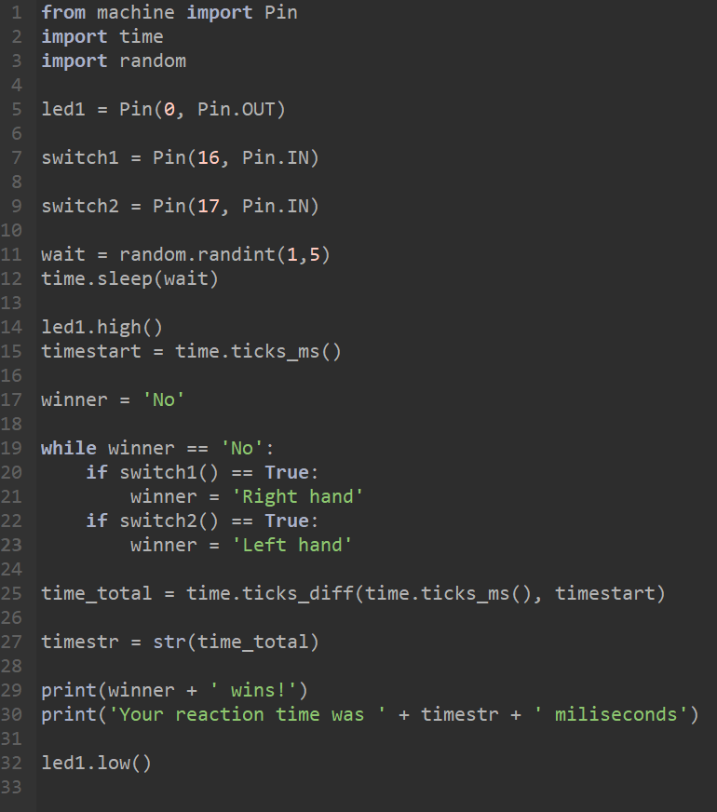
tf-links.com

